Slide 1



Supporting Children and Young People’s Transition to High School
Parent/Carer Workshop

Slide 2

Aim of the session
To support parents and carers to explore practical ideas and advice on supporting their child’s transition to high school
Explore change and its potential impact on mental health
Consider the challenges posed by transition to secondary school
Explore ways in which we can support young people

Slide 3
Group Agreement
Supportive learning environment.
Please participate – All Contributions are welcome
Everyone’s input is equally valued
Listen with an open mind
Confidentiality – please don’t repeat what is shared out of this session
Networking – building relationships with MHST.
Feedback at the end please

Slide 4


My name is……

Slide 5

Moving from Primary to Secondary
The move from primary to secondary school comes at a time of great change for children
Adapting to a new school environment
Developing new relationships
As a parent or carer there is much you can do to help your child through the transition period with careful and sensitive preparation
Many Parents feel anxious when their children start Secondary school
Notes:
The transition from primary to secondary school is exciting for children and marks a new phase in their lives
Most children adapt to secondary school well. However, if your child
struggles with their new environment, it can be stressful not only to
them, but for you as parents and carers, too. It’s important to take this
into account as you help your child prepare for secondary school.

Slide 6
Lots of changes for young people to navigate
Going from Oldest to Youngest
Lots of new information to take in and learn
New friendships groups
Size of School
More Homework
More travelling
https://www.youtube.com/watch?v=thnoUraeoGs
Notes:
https://youtu.be/thnoUraeoGs play Anna Freud Moving up You Tube clip

Slide 7
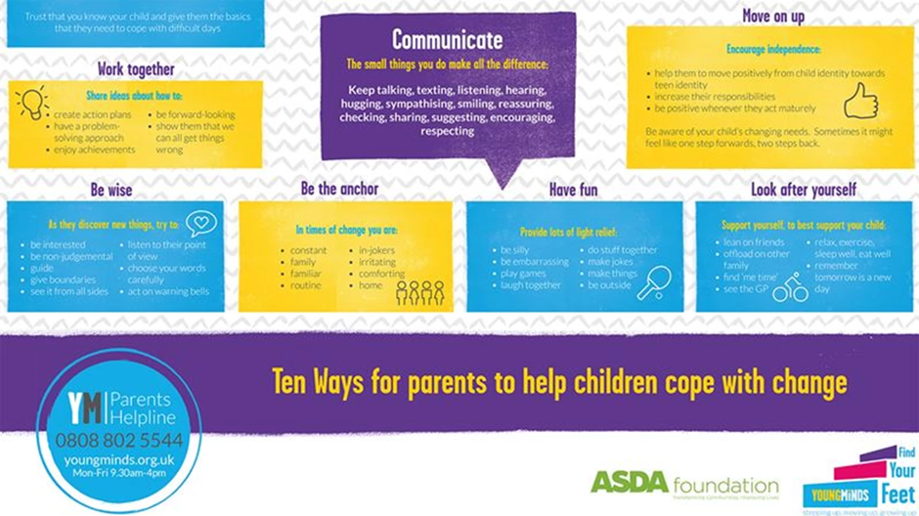

Notes:
What changes will be in place at school – Face coverings, testing

Slide 8
What are children most worried about?
Not being in a class with their friends
Getting lost, being late to class
Being isolated, not making friends
Harder Homework
Detention
Being Bullied
Not fitting in, what people think of me
Meeting new teachers. Too many teachers
Information taken from Young Minds – ‘Find your feet’ project

Slide 9
What are children excited about?
Being independent
Making new friends
New environment
Sports, clubs, activities
Learning new things, new subjects
More responsibility
School trips
Having my own stationary
Information taken from Young Minds – ‘Find your feet Project

Slide 10

How Transition can affect children and young people
It is not a single event
Long-lasting effect on academic outcomes
Perceived loss of control
Loss of attachment
Can impact on self-esteem and emotional wellbeing
Uncertainty
Unpredictable environment
Notes:
With a well-planned transition, led by highly skilled adults, most children will swiftly settle and become comfortable in their new environment. But, occasionally there are children who continue to struggle. These children can present as angry, confused and defiant. All behaviour, both positive and negative, is a form of communication.

Slide 11
Helping your child through transition
Encouraging them to explore their feelings
Help them connect to their school
Building friendships and relationships; empowering them by building their confidence
Independence.

Slide 12
Helping your child to be organised
Visit
Visit the school website
Plan
Plan the route to school
Know
Know what uniform is needed and buy it
Help
Help children get into a good routine
Support
Support them to take responsibility for the things they need to prepare each day

Slide 13
12 Steps to help with Transition
Visit the School Website
Practise Packing
Practise Buying Food
Plan your Route
Planner/Diary
School Map
Get Into a Good Routine
Talk to friends
Prepare Your Uniform
Take Responsibility
Taken from ‘My Moving Up To Secondary School booklet – By Compass

Slide 14

Things to put in place now
Encourage Independence
Opportunity to buy things
Go places on their own
Get Familiar with School
Drive by the school – Help with visualising the building/ seeing how other children wear the uniform
Attend any transition events online or Face 2 face
Finally
Make a plan with your young person

Slide 15
Resources for young People
www.bbc.co.uk/bitesize/tags/zh4wy9q/starting-secondary-school/1
https://youngminds.org.uk/media/3919/find-your-feet-pupil-resource-2020.pdf
https://youngminds.org.uk/media/3919/find-your-feet-pupil-resource-2020.pdf
Childline - https://www.childline.org.uk/
Anna Freud - https://www.annafreud.org/on-my-mind/
Young Minds - https://youngminds.org.uk/find-help/looking-after-yourself/believe-in-yourself/ - Helping with Self Esteem
Watch
https://www.youtube.com/watch?v=thnoUraeoGs – Anna Freud- Moving Up! The transition to secondary school
https://www.youtube.com/watch?v=IPitcRTE4ZE – Dorset MHST
https://youtu.be/xT6ctrk3pVQ - Young Minds - Find your Feet
Notes:
https://www.youtube.com/watch?v=A--IqF18DSs

Slide 16

Resources for Parents
https://www.youngminds.org.uk/professional/resources/supporting-school-transitions/ - Scroll down for Parent webinar
Anna Freud - https://www.annafreud.org/parents-and-carers/
Young Minds - https://youngminds.org.uk/find-help/for-parents/
Watch Video’s
https://www.bbc.co.uk/bitesize/articles/znprhbk – Supporting your child emotionally
https://www.bbc.co.uk/bitesize/articles/znncpg8 -practical advice

Slide 17



Useful Apps
Notes:
Explain apps
Kooth https://www.kooth.com/ is anonymous and free at the point of use. Online counselling is available to users through instant chat messaging from mid-day until 10pm on weekdays and from 6pm until 10pm at weekends.
Mindshift CBT is a free self-help anxiety relief app, that helps you reduce worry, stress, and panic by following evidence-based strategies
Clear Fear – helps learn how to reduce the physical responses to threat as well as changing thoughts and behaviours and releasing emotions.

Slide 18


