Slide 1
Can I reflect on the stories I have heard?
(Can I write a story review?)

Slide 2
What stories have we looked at?
The Rat and the Captain – The poem about a Pearl Boat Captain’s problem with rats aboard his boat and the response of the rat.
Ali Baba and the Forty Thieves – The story of Ali Baba finding gold and riches that belonged to a group of thieves, how the thieves plotted revenge and ultimately how Morgianna saved the day!
The Cat and the Mouse – The fable about how a mouse helped a cat escape from a trap in exchange for a favour.
Gilgamesh the Hero – The epic tale of a horrible man who changed his ways (thanks to Enkidu) and went on different quests.

Slide 3
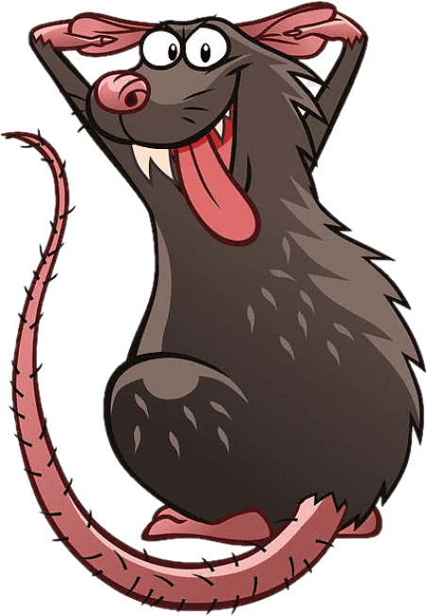
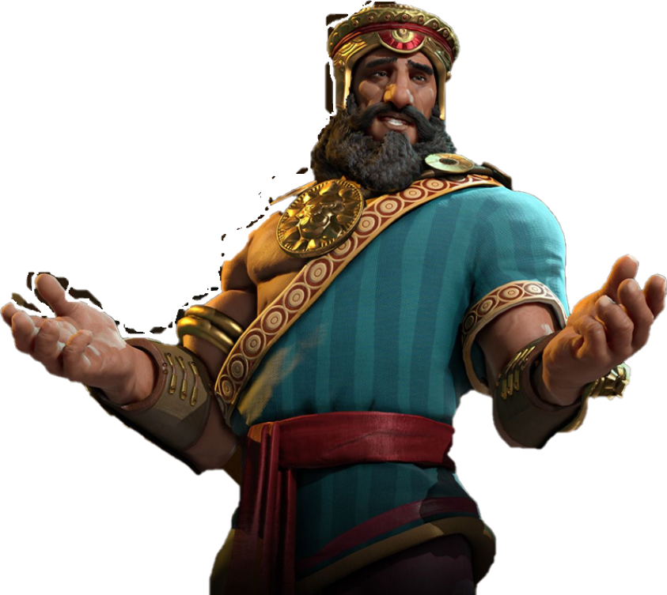


Which story was your favourite?
My story is an epic tale of friendship, beasts and magic!
I annoyed the Pearl boat Captain!
What about all the treasure in the cave?
My story is one that teaches not to trust your enemies

Slide 4


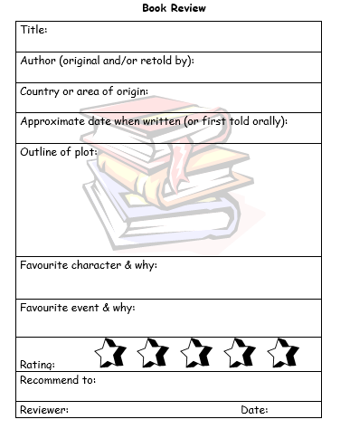

Complete the story review for your favourite story!

