Slide 1
The Epic of Gilgamesh
Can I read and understand a story from another culture?

Slide 2
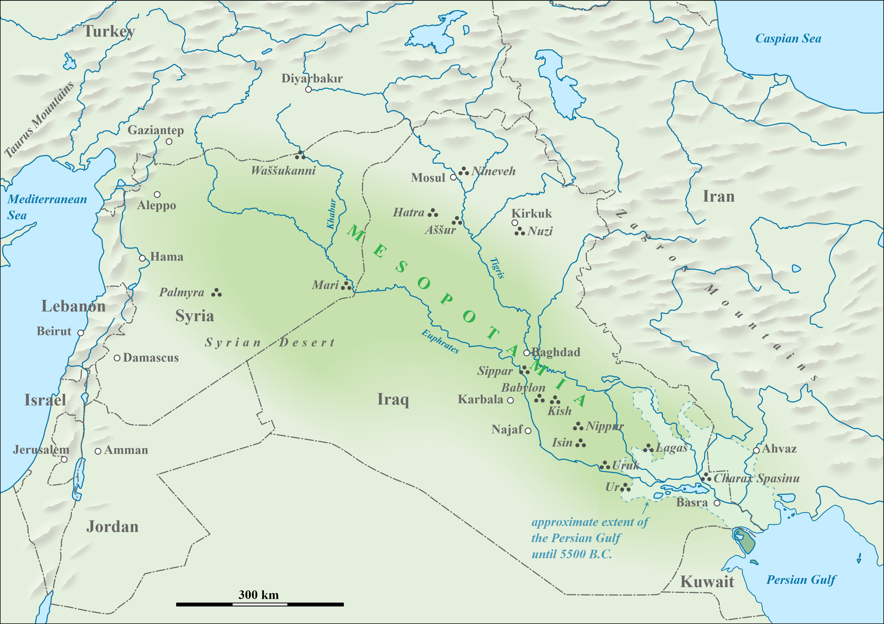
Mesopotamia
(its part of the middle east!)

Slide 3
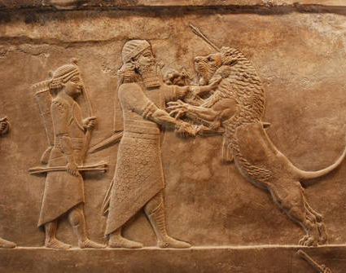
Mesopotamia
Mesopotamia is a historical region of Western Asia situated within the Tigris–Euphrates river system.

Slide 4
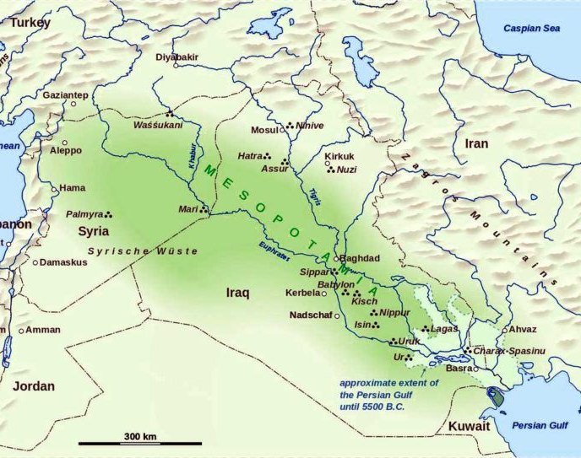
Mesopotamia
Mesopotamia (from the Greek, meaning 'between two rivers’).
Today it includes modern day Iraq and parts of Iran, Syria and Turkey

Slide 5
GILGAMESH!
READ THIS EPIC PEOM FROM THE MESOPOTAMIA REGION

Slide 6
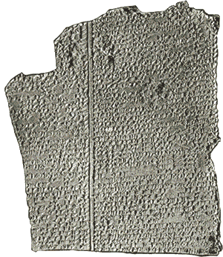

The Epic of Gilgamesh Mesopotamia
The Epic of Gilgamesh is among the earliest known works of literature. An epic is a long poem that tells the story of legendary or heroic people or gods. Like most
epics, the first stories of
Gilgamesh began as oral
fables handed down by
word of mouth. Hundreds
of years after the poets
first spoke of Gilgamesh,
the legends were collected
and recorded on clay tablets.

Slide 7
The Epic of Gilgamesh Mesopotamia
The Epic of Gilgamesh is among the earliest known works of literature. An epic is a long poem that tells the story of legendary or heroic people or gods. Like most
epics, the first stories of
Gilgamesh began as oral
fables handed down by
word of mouth. Hundreds
of years after the poets
first spoke of Gilgamesh,
the legends were collected
and recorded on clay tablets.

Slide 8
The Epic of Gilgamesh Mesopotamia
The Epic of Gilgamesh is among the earliest known works of literature. An epic is a long poem that tells the story of legendary or heroic people or gods. Like most
epics, the first stories of
Gilgamesh began as oral
fables handed down by
word of mouth. Hundreds
of years after the poets
first spoke of Gilgamesh,
the legends were collected
and recorded on clay tablets.

Slide 9
The Epic of Gilgamesh Mesopotamia
The Epic of Gilgamesh is among the earliest known works of literature. An epic is a long poem that tells the story of legendary or heroic people or gods. Like most
epics, the first stories of
Gilgamesh began as oral
fables handed down by
word of mouth. Hundreds
of years after the poets
first spoke of Gilgamesh,
the legends were collected
and recorded on clay tablets.

Slide 10
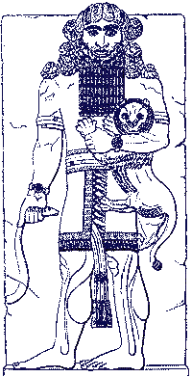
The Epic of Gilgamesh Mesopotamia
The story takes place nearly five thousand years ago. Gilgamesh was the king of the wealthy city of Urduk. The king was strong and handsome, but he was also cruel. Gilgamesh forced the people of Urduk to build him great palaces. He also made his subjects live in constant fear. When the people of Urduk begged the gods for help, they led Enkidu to Urduk.

Slide 11
The Epic of Gilgamesh Mesopotamia
The story takes place nearly five thousand years ago. Gilgamesh was the king of the wealthy city of Urduk. The king was strong and handsome, but he was also cruel. Gilgamesh forced the people of Urduk to build him great palaces. He also made his subjects live in constant fear. When the people of Urduk begged the gods for help, they led Enkidu to Urduk.

Slide 12
The Epic of Gilgamesh Mesopotamia
The story takes place nearly five thousand years ago. Gilgamesh was the king of the wealthy city of Urduk. The king was strong and handsome, but he was also cruel. Gilgamesh forced the people of Urduk to build him great palaces. He also made his subjects live in constant fear. When the people of Urduk begged the gods for help, they led Enkidu to Urduk.

Slide 13
The Epic of Gilgamesh Mesopotamia
The story takes place nearly five thousand years ago. Gilgamesh was the king of the wealthy city of Urduk. The king was strong and handsome, but he was also cruel. Gilgamesh forced the people of Urduk to build him great palaces. He also made his subjects live in constant fear. When the people of Urduk begged the gods for help, they led Enkidu to Urduk.

Slide 14
The Epic of Gilgamesh Mesopotamia
The story takes place nearly five thousand years ago. Gilgamesh was the king of the wealthy city of Urduk. The king was strong and handsome, but he was also cruel. Gilgamesh forced the people of Urduk to build him great palaces. He also made his subjects live in constant fear. When the people of Urduk begged the gods for help, they led Enkidu to Urduk.

Slide 15
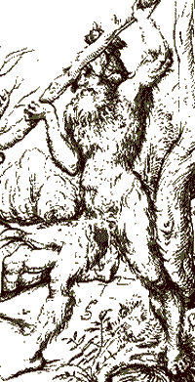
The Epic of Gilgamesh Mesopotamia
Enkidu was also big and strong, but he was wild and ignorant of the ways of civilized people. Enkidu was raised in the
forest where he lived with the
animals. When Enkidu learned
of Gilgamesh's cruelty, the wild
man challenged the mighty king
to fight. As the two powerful
men battled, they realized they
admired one another; so instead
of remaining enemies, they
became inseparable friends.

Slide 16
The Epic of Gilgamesh Mesopotamia
Enkidu was also big and strong, but he was wild and ignorant of the ways of civilized people. Enkidu was raised in the
forest where he lived with the
animals. When Enkidu learned
of Gilgamesh's cruelty, the wild
man challenged the mighty king
to fight. As the two powerful
men battled, they realized they
admired one another; so instead
of remaining enemies, they
became inseparable friends.

Slide 17
The Epic of Gilgamesh Mesopotamia
Enkidu was also big and strong, but he was wild and ignorant of the ways of civilized people. Enkidu was raised in the
forest where he lived with the
animals. When Enkidu learned
of Gilgamesh's cruelty, the wild
man challenged the mighty king
to fight. As the two powerful
men battled, they realized they
admired one another; so instead
of remaining enemies, they
became inseparable friends.

Slide 18
The Epic of Gilgamesh Mesopotamia
Enkidu was also big and strong, but he was wild and ignorant of the ways of civilized people. Enkidu was raised in the
forest where he lived with the
animals. When Enkidu learned
of Gilgamesh's cruelty, the wild
man challenged the mighty king
to fight. As the two powerful
men battled, they realized they
admired one another; so instead
of remaining enemies, they
became inseparable friends.

Slide 19
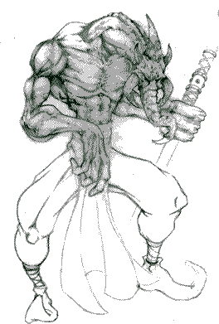
The Epic of Gilgamesh Mesopotamia
The unlikely pair left Urduk to embark on many adventures. Gilgamesh and Enkidu entered the forbidden Cedar Forest where the gods lived, but they soon faced a grotesque monster named Humbaba.

Slide 20
The Epic of Gilgamesh Mesopotamia
The unlikely pair left Urduk to embark on many adventures. Gilgamesh and Enkidu entered the forbidden Cedar Forest where the gods lived, but they soon faced a grotesque monster named Humbaba.

Slide 21
The Epic of Gilgamesh Mesopotamia
"in order to protect the Cedar Forest [the gods] assigned Humbaba as a terror to human beings; Humbaba's roar
is a flood, his mouth is
fire, and his breath is
death!”

Slide 22
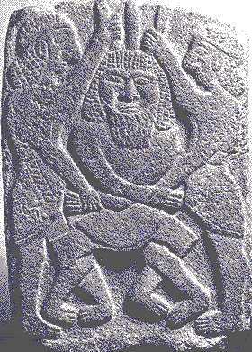
The Epic of Gilgamesh Mesopotamia
Gilgamesh and Enkidu tricked the beast, so the powers of Humbaba were spread over the lands of Sumer.

Slide 23
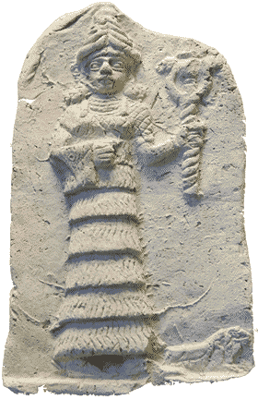
The Epic of Gilgamesh Mesopotamia
Gilgamesh displeased the goddess Ishtar, so she sent the fearsome Bull of Heaven to destroy the crops of the Sumerian farmers. Gilgamesh and Enkidu killed the bull. This enraged the gods, so they caused Enkidu to fall ill and die.

Slide 24
The Epic of Gilgamesh Mesopotamia
Gilgamesh displeased the goddess Ishtar, so she sent the fearsome Bull of Heaven to destroy the crops of the Sumerian farmers. Gilgamesh and Enkidu killed the bull. This enraged the gods, so they caused Enkidu to fall ill and die.

Slide 25
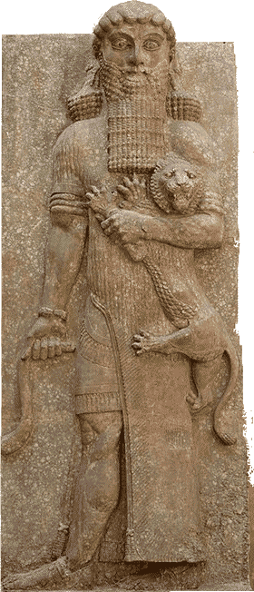
The Epic of Gilgamesh Mesopotamia
Gilgamesh was heartbroken by the death of his friend. The king also feared that one day he would also die, so Gilgamesh began to search for the secret of eternal life.

Slide 26
The Epic of Gilgamesh Mesopotamia
Gilgamesh was heartbroken by the death of his friend. The king also feared that one day he would also die, so Gilgamesh began to search for the secret of eternal life.

Slide 27
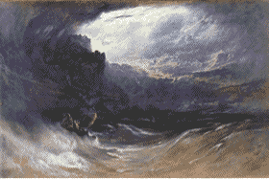
The Epic of Gilgamesh Mesopotamia
One version of the epic describes a terrible flood that covered the earth many years
before the time of Gilgamesh.

Slide 28
The Epic of Gilgamesh Mesopotamia
Gilgamesh went on a long journey to meet Utnapishtim, an elderly man who survived the flood because the gods warned him of the coming deluge. Utnapishtim told Gilgamesh,

Slide 29
The Epic of Gilgamesh Mesopotamia
"the life that you are seeking you will never find. When the gods created man they allotted to him death, but life they retained
in their own keeping."

Slide 30
The Epic of Gilgamesh Mesopotamia
"the life that you are seeking you will never find. When the gods created man they allotted to him death, but life they retained
in their own keeping."

Slide 31
The Epic of Gilgamesh Mesopotamia
Gilgamesh returned home with wisdom from his adventures with Enkidu and Utnapishtim. Gilgamesh became a gentle ruler who no longer mistreated the people of Urduk. Gilgamesh realized that he could not escape death, but he could live on in the memories of the people he loved.

Slide 32
The Epic of Gilgamesh Mesopotamia
Gilgamesh returned home with wisdom from his adventures with Enkidu and Utnapishtim. Gilgamesh became a gentle ruler who no longer mistreated the people of Urduk. Gilgamesh realized that he could not escape death, but he could live on in the memories of the people he loved.

Slide 33
The Epic of Gilgamesh Mesopotamia
Gilgamesh returned home with wisdom from his adventures with Enkidu and Utnapishtim. Gilgamesh became a gentle ruler who no longer mistreated the people of Urduk. Gilgamesh realized that he could not escape death, but he could live on in the memories of the people he loved.

Slide 34
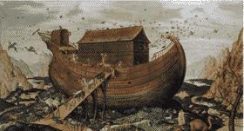
The Epic of Gilgamesh Mesopotamia
The Epic of Gilgamesh had many parallels to the story of Noah and a great flood in the Old Testament of the Jewish and Christian holy books. Other cultures also have legends of a great flood.

Slide 35
The Epic of Gilgamesh Mesopotamia
The Epic of Gilgamesh had many parallels to the story of Noah and a great flood in the Old Testament of the Jewish and Christian holy books. Other cultures also have legends of a great flood.

Slide 36
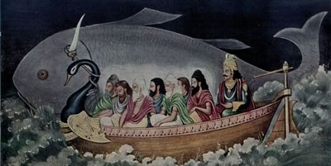
The Epic of Gilgamesh Mesopotamia
The Greeks legends say a god named Zeus once unleashed a flood because he was displeased with a sacrifice made in his name. The Hindus speak of Manu, a Brahmin king who saved mankind from a deluge.

Slide 37
The Epic of Gilgamesh Mesopotamia
The Greeks legends say a god named Zeus once unleashed a flood because he was displeased with a sacrifice made in his name. The Hindus speak of Manu, a Brahmin king who saved mankind from a deluge.

Slide 38
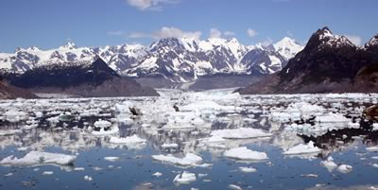
The Epic of Gilgamesh Mesopotamia
Modern science has discovered that there was a marked increase in the sea levels about 6,000 years ago as the last ice age ended. The melting ice drained to the ocean causing the sea levels to rise more than ten feet in one century. Gilgamesh and the other flood legends may be connected with the end of the ice age.

Slide 39
The Epic of Gilgamesh Mesopotamia
Modern science has discovered that there was a marked increase in the sea levels about 6,000 years ago as the last ice age ended. The melting ice drained to the ocean causing the sea levels to rise more than ten feet in one century. Gilgamesh and the other flood legends may be connected with the end of the ice age.

Slide 40
The Epic of Gilgamesh Mesopotamia
Modern science has discovered that there was a marked increase in the sea levels about 6,000 years ago as the last ice age ended. The melting ice drained to the oceans causing the sea levels to rise more than ten feet in one century. Gilgamesh and the other flood legends may be connected with the end of the ice age.

