Slide 1
Can I retell a story from a different perspective?
Lesson 8

Slide 2
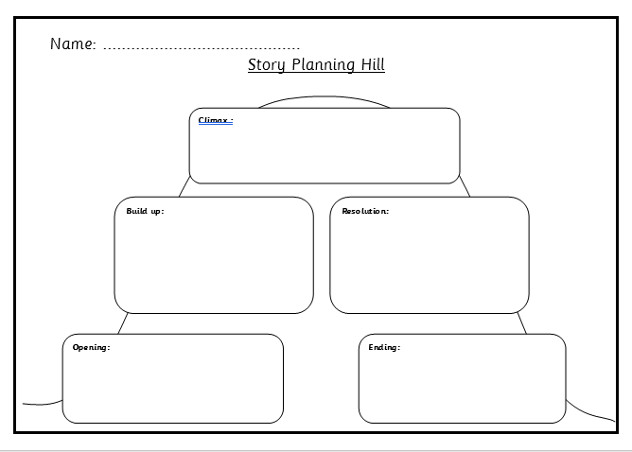
Your task
Can you write the story of Ali Baba and the Forty Thieves from the perspective of morgianna?

Slide 3
What is going to be the title of your story?
Morgianna and the Forty Thieves!
Morgianna, the Saviour of Ali Baba!
Magnificent Morgianna Saves the Day!

Slide 4
What else can help with my writing?
Alan Peat sentences - The more the Shoe Maker tried, the more difficult it became to sell his shoes.
Year 5/6 word list

Slide 5
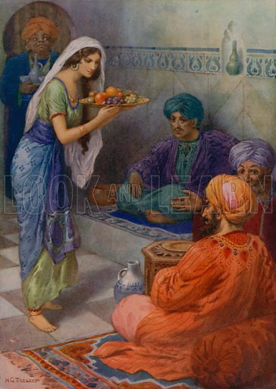
You can present your work on Microsoft word or paper, it’s completely up to you!
If you need some more help writing your story, why don’t you check out BBC bitesize?
https://www.bbc.co.uk/bitesize/topics/zpccwmn

Slide 6
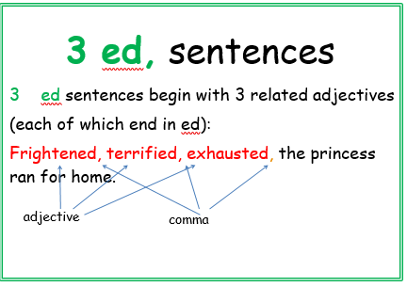
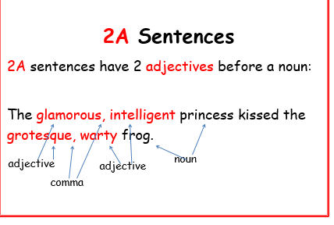
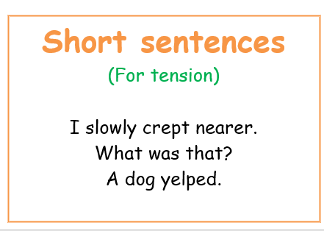
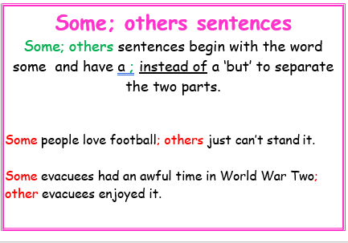

Slide 7
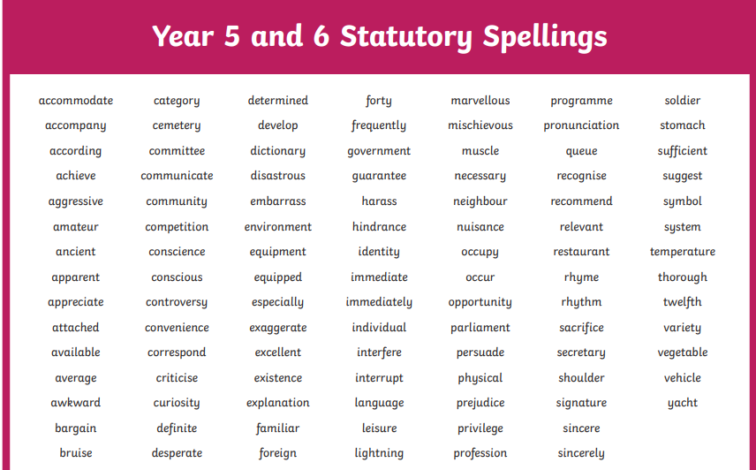

Slide 8


