Slide 1
Can I retell a story from a different perspective?
Lesson 7

Slide 2
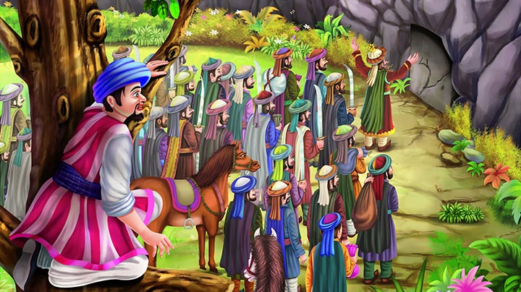
Ali baba and the forty thieves
This is a tale from the gulf region.
It’s a famous story from Persia of how Ali Baba outwitted a band of robbers with a little help from the clever slave-girl, Morgiana.

Slide 3
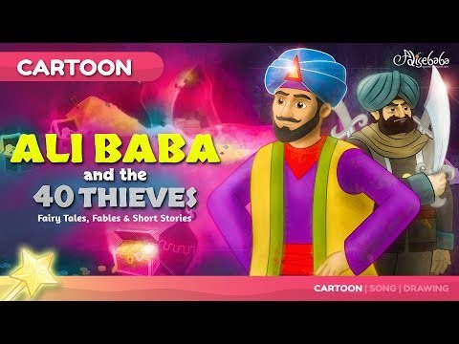
Let’s watch the cartoon of Ali Baba and the Forty Thieves

Slide 4
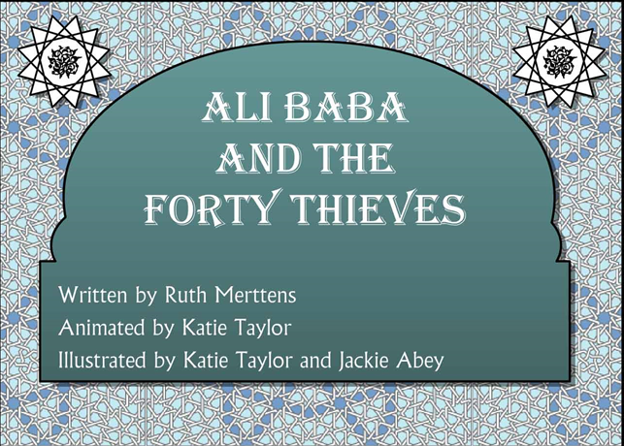
Can you read the story again? From what perspective is the story told?

Slide 5
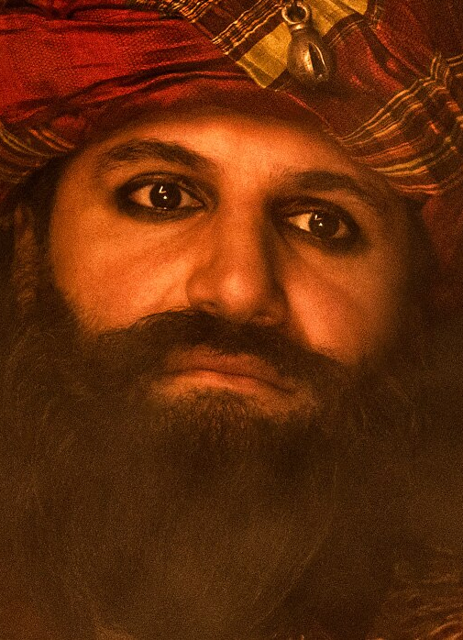
Ali baba and the forty thieves
Who is the main character of the story?
Ali Baba
This is my story so you will see things from my point of view!

Slide 6
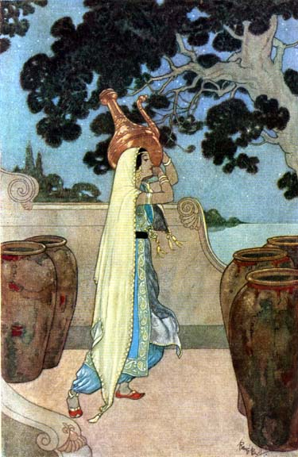
Morgianna
She is the servant girl who saves the lives of Ali Baba and his family.
What would the story be like if we told it from her point of view?

Slide 7

How could we change the story if we wrote from Morgianna’s point of view?
Well, if we are writing the story from my point of view, the story will definitely be different!
It may have a different starting point as well!
It would focus on my role in the story and what actions I take!

Slide 8
Ali baba story point of view
Morgianna’s story point of view
Ali Baba took money from the cave, he brought home the money and he and his family moved into a comfortable house.
But Ali Baba’s wife could not help boasting to her sister-in-law. She told her that Ali Baba was richer than Cassim. Cassim came to his brother and threatened him:
“I will tell everyone you have stolen some treasure if you do not show me where you found it!”
Morgianna was a servant girl who worked for Ali Baba and his family, they lived in a big, beautiful house. Morgianna loved the family and her work as they treated her well
One day, overheard Ali Baba’s brother, Cassim, threatening Ali Baba. Apparently, they had stolen the money they now had. Cassim made Ali Baba take him to the cave. Morgianna became very worried.

Slide 9
How will the story change if it’s from Morgianna’s point of view?
It will start after Ali Baba finds the gold.
It might include what she does for the family.
When she finds out what has happened, she decides to protect the family.
It might focus on how intelligent she is, after all she is the one who puts the crosses on the other doors and boils the soldiers in the oil pots!

Slide 10
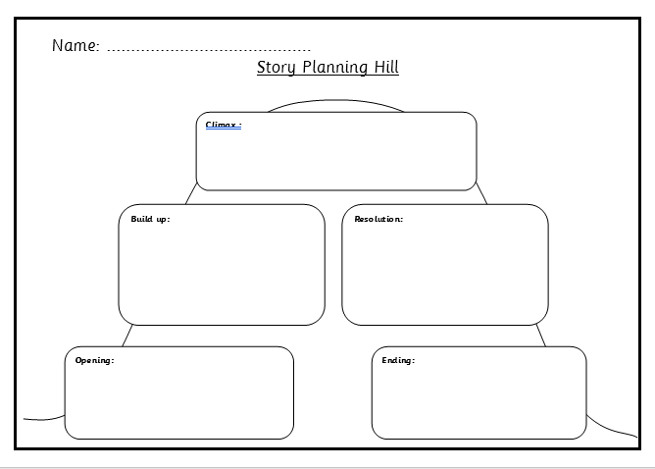
Your task
Can you plan to retell the story of Ali Baba and the Forty Thieves from the perspective of morgianna?

