Slide 1
Can I identify words that originate from other languages?
Lesson 6

Slide 2
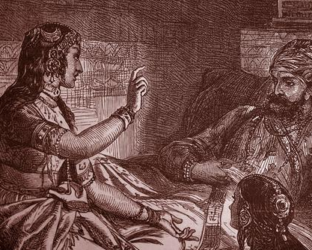
Scheherazade and the 1001 Nights
Scheherazade or Shahrazad is a legendary Persian queen and the storyteller of One Thousand and One Nights.

Slide 3
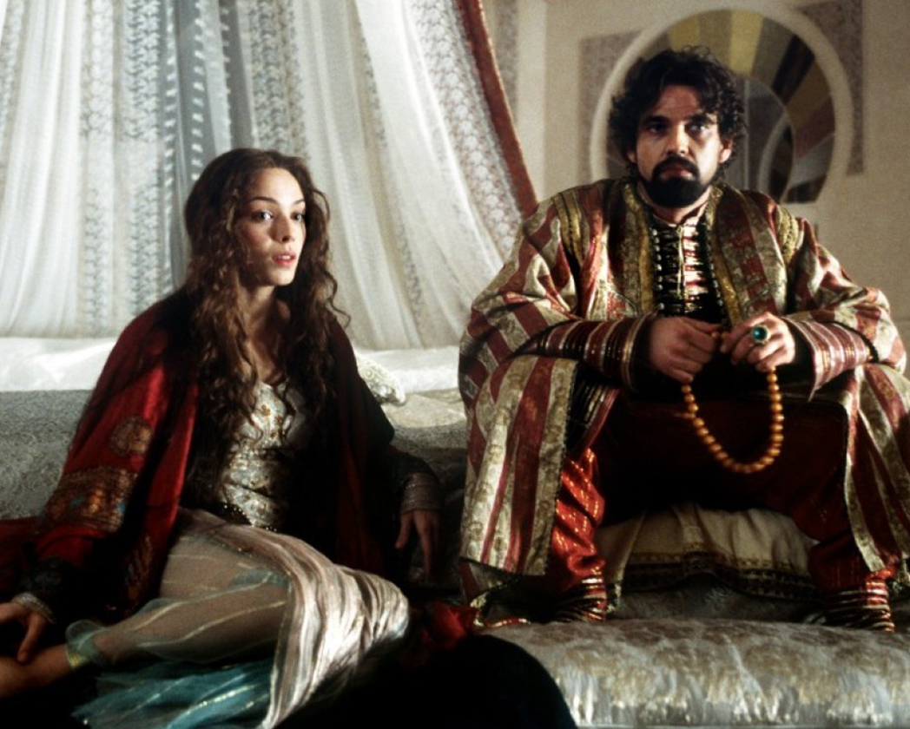
The frame tale goes that every day Shahryar (Persian for king) would marry a new woman, and the following morning he would send her to be beheaded.
This was done in anger, having found out that his first wife was betraying him. He had killed three thousand such women by the time he was introduced to Scheherazade, the vizier's daughter.

Slide 4
Scheherazade and the 1001 Nights
Once upon a time, the Sultan Shahriyar has a beautiful wife whom he loves. Unfortunately, the Sultan has to go off to war. He is gone for a while. When he returns, he finds his wife has gone off with another man.
The Sultan is consumed with anger and grief. He is so upset and angry that he decides to punish all women because his wife has left him. First of all, he beheads his wife.
Shortly after, he marries a woman and then, immediately after the wedding night, he has her beheaded. He continues to do this again and again, always having his wives beheaded after the wedding night.

Slide 5
Scheherazade and the 1001 Nights
The Grand Vizier to the Sultan has a beautiful daughter, Scheherazade. She says what the Sultan is doing is dreadful and it cannot continue. Her father tells her not to get involved. She assures her father she knows what she is doing.
Scheherazade insists upon marrying the Sultan. On their first evening of marriage, the Sultan asks her what she enjoys doing. She tells him that she enjoys telling stories and is renowned for telling the most fabulous stories ever heard.
The Sultan is curious. He commands his new wife to tell him a story. She begins telling him the most amazing story which completely captivates the Sultan. She does not finish it before the end of the night but promises she will finish it on the next night if she is allowed to live. The Sultan allows her to live to the second night so she can finish the story.

Slide 6
Scheherazade and the 1001 Nights
Scheherazade finishes the story, but she intertwines a new story which has just begun. She says she will finish this on the next night. Again the Sultan allows her to live so he can hear the end of the story.
Things continue like this for 1001 nights, with Scheherazade keeping the Sultan entertained with her wonderful stories. In the end, the Sultan falls in love with Scheherazade and allows her to live on as his wife. They live happily ever after.

Slide 7
1001 Arabian Nights
A frame story (also known as a frame tale or frame narrative) is a literary technique.
It is a companion piece to a story within a story, where an introductory or main narrative (story) sets the stage either for a more emphasized second narrative or for a set of shorter stories.
In this case, Scheherazade and the 1001 Nights is the companion piece; the stories she tells the Sultan every night are the other stories found in this book!

Slide 8



Frame Stories
These are all examples of frame stories

Slide 9


Frame Stories
These two books are also examples of a frame story, with the Canterbury tales being similar to 1001 Arabian Nights as there are large selection of other stories within it.

Slide 10
Words from Other Cultures
Another word for a robber is bandit (Italian)
Another word for a forest is jungle (Indian, Hindi)
The chief robber pretended to be an oil merchant (French).
He might also have sold alcohol (Arabic)
Merchants sold things in the bazaar (Persian)
A precious stone or jewel (Persian/Arabic) might be an emerald (Persian/Arabic)
The English language, which has developed over the centuries, has been enriched by words and phrases from other parts of the world. This means that words we use everyday have come from all over the world!
Look at the examples.

Slide 11
Your task is to find out where the words below came from? Can you write a definition of the meaning?
hurricane
tornado
bog
algebra
bandanna
bangle
giraffe
clobber
juggernaut
tomato
potato
banana
orange
tea
coffee
bungalow
spaghetti
boutique

