Slide 1
Can I recognise stories from a different culture and time?
Lesson 5

Slide 2
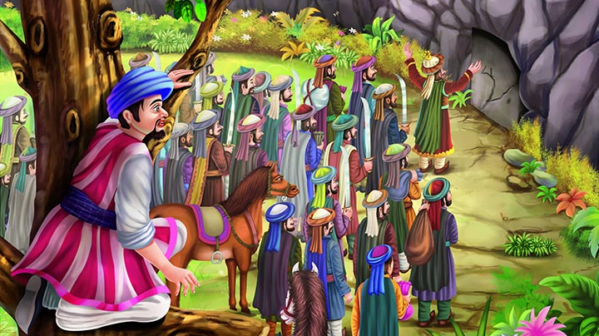
Ali baba and the forty thieves
This is a tale from the gulf region.
It’s a famous story from Persia of how Ali Baba outwitted a band of robbers with a little help from the clever slave-girl, Morgianna.

Slide 3
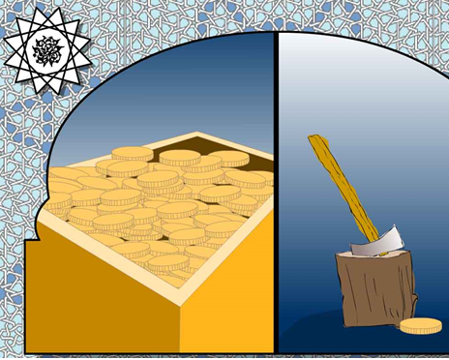
Ali baba and the forty thieves
Ali Baba and Cassim were two brothers.
Cassim was rich and lived in wealth and plenty.
Ali Baba was a woodcutter, struggling to make a living.
He and his wife and children were very poor.

Slide 4
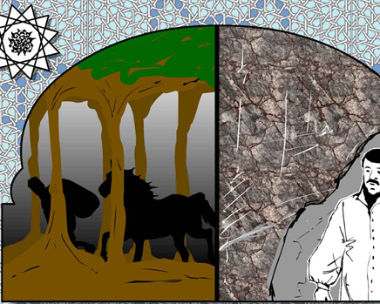
Ali Baba was in the forest and he saw a troop of robbers. They were riding past carrying bags of silver and gold. Being very frightened he hid behind some rocks on the mountainside. He saw the robbers ride round the mountain towards a sheer cliff face. Then the leader of the robbers – a tall cunning man - paused the company and shouted at the mountainside:

Slide 5
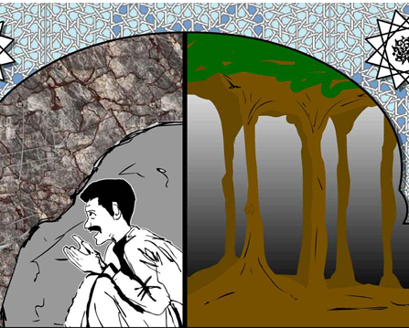
‘Open Sesame!’
To Ali Baba’s astonishment the cliff swung open and the entire troop rode into the huge cavern. The mountain shut behind them. Ali Baba was too scared to move. He stayed hidden behind the rocks. Finally he saw the troops reappear from the mountain. The robbers scattered and galloped off through the forest. Ali Baba waited, then he approached the cliff face…..

Slide 6
What will happen next?
Will he follow the robbers into the mountain?
Will he go and call for help?
Will someone find him?
Can you make a prediction and write it down?
Can you explain, based on what you have read so far, why you have predicted this?

Slide 7
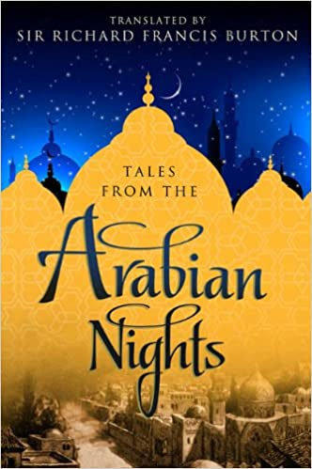
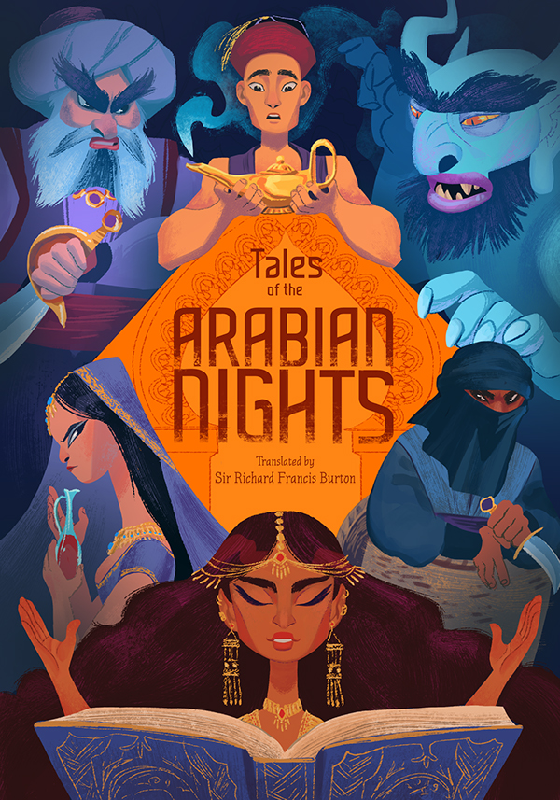
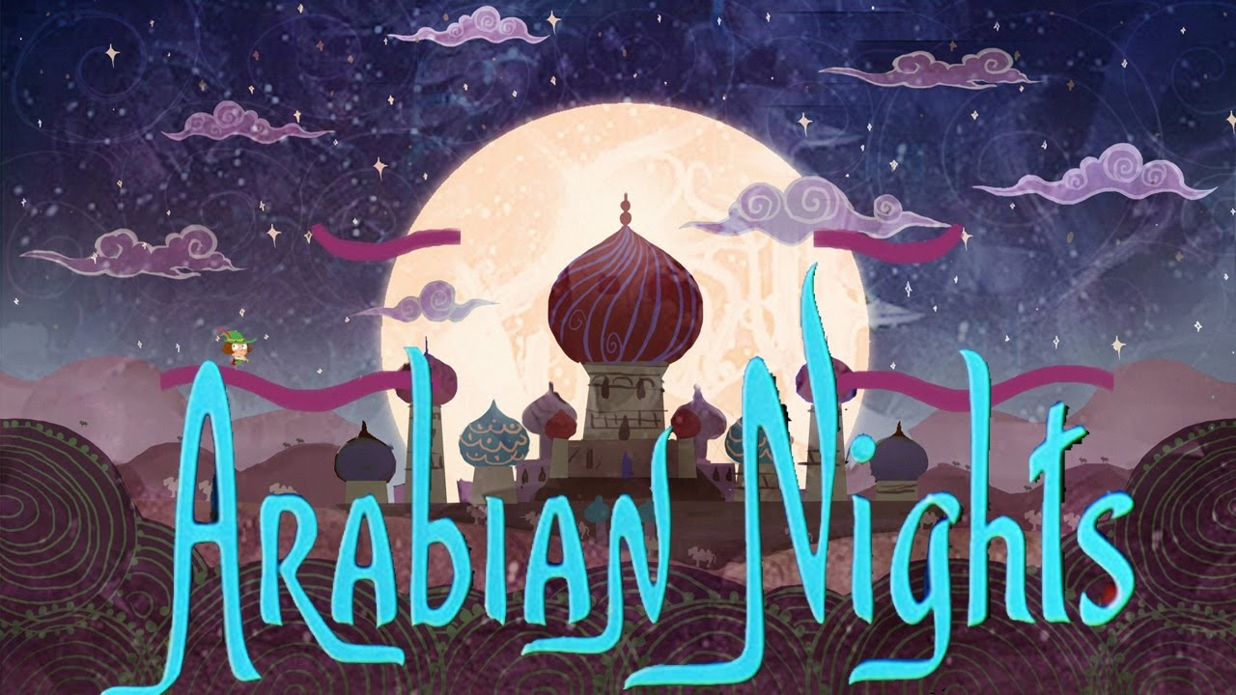
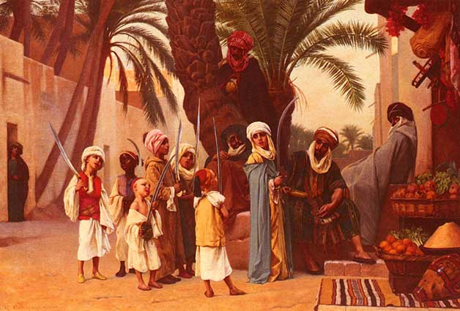
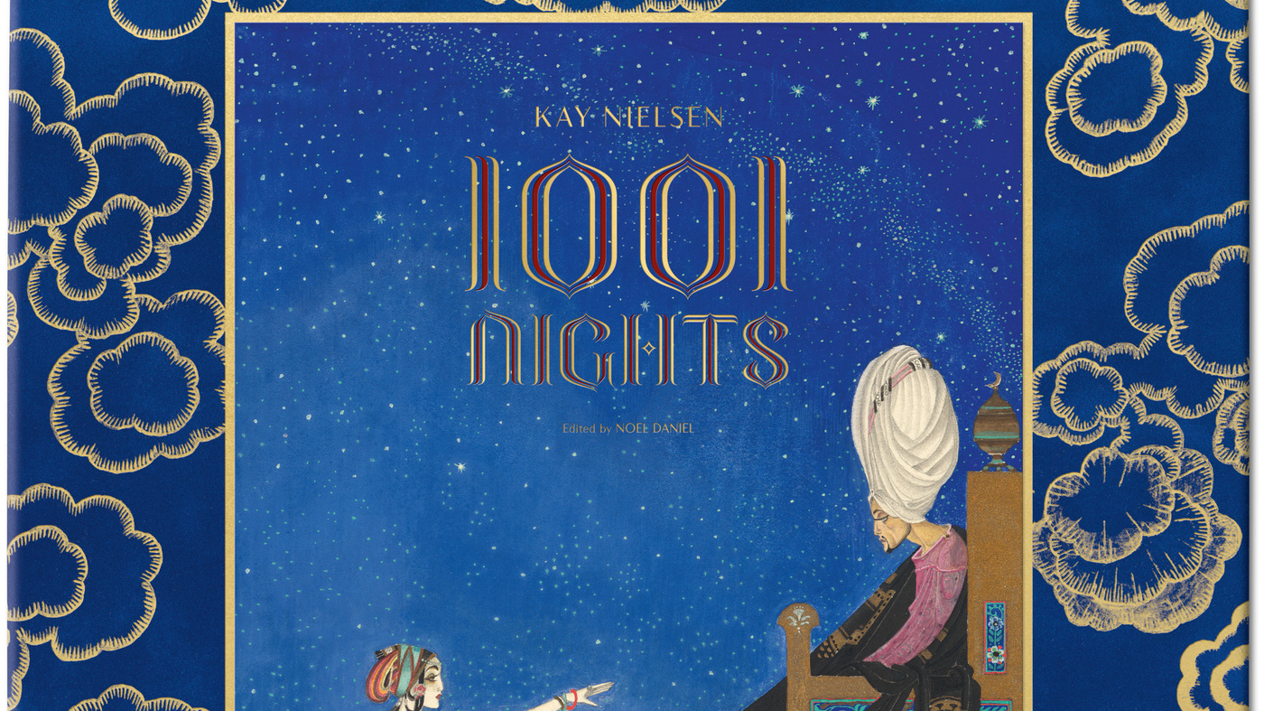
The story of Ali Baba and the Forty Thieves is a story from a collection entitled:
One Thousand and One Arabian Nights

Slide 8

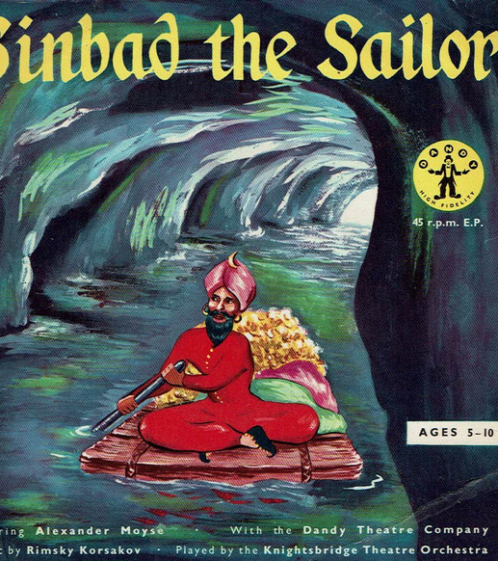
Have you heard of these stories?
They are also from 1001 Arabian Nights!

Slide 9
One thousand and one Arabian nights
‘1001 nights’ in Arabic means ‘very many nights’.
This is a collection of middle eastern folk tales compiled in Arabic during the Islamic Golden Age.
Some of the stories trace back to medieval Arabic, Persian, Indian, Greek, Jewish and Turkish folklore and tradition.
These stories were re-told orally so they will have changed over time and were originally intended for adults, full of description and philosophical reflections on life.
The work is collected over many centuries and was compiled in English for the first time around 1706.
In the mid-20th century, the scholar Nabia Abbott found a document with a few lines of an Arabic work with the title The Book of the Tale of a Thousand Nights, dating from the 9th century. This is the earliest known surviving fragment of the book.

Slide 10
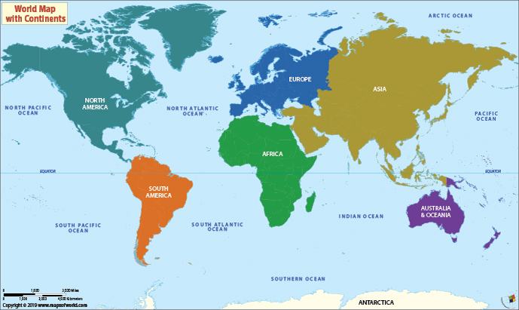
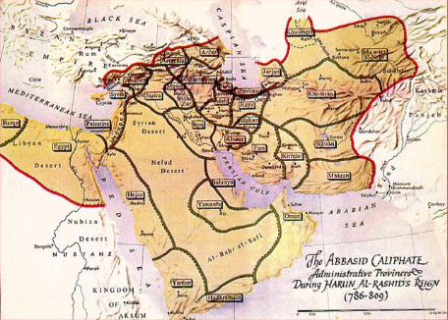

Slide 11
The origins of the stories all come from this region

Slide 12
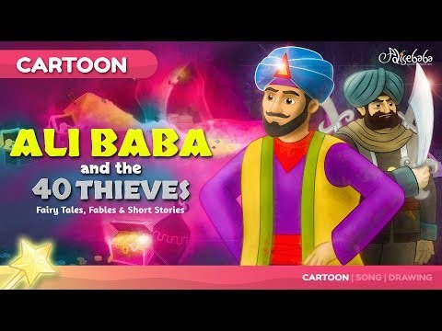
Can you watch the cartoon of Ali Baba and the Forty Thieves

Slide 13
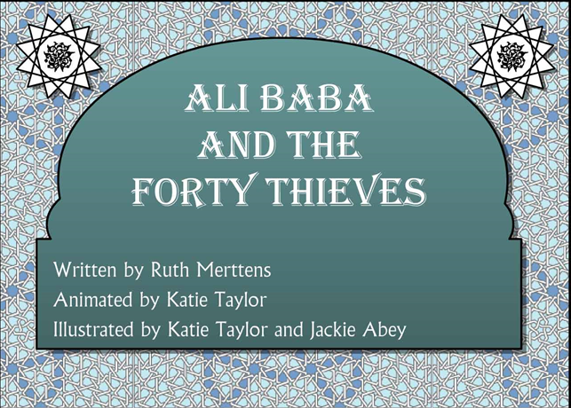
Can you read the story. How does it compare to the cartoon? Is the story the same?

Slide 14


What was life like in the middle east during the 9th century
The Gulf, Medieval times.
Huddersfield 2020.
There was no running water in homes, instead people used things like chamber pots and emptied them out on the street!
Today people have running water in the home and can use the toilet whenever they want! We have a fantastic sewer system in his country as do many other countries.

Slide 15
Your Task.
Can you compare and contrast life now and life in the setting of Ali Baba and the Forty Thieves?
The Gulf, Medieval times
Huddersfield 2020
How did they dress?
What did they do?
What were their houses like?
How did they travel?
You can present your work however you wish!

