Slide 1
Tales from other countries
Can I write an explanation text?

Slide 2
What is an explanation text?
..\lesson 3 explanation text\T2-E-199-Tips-for-Writing-Explanation-Powerpoint_ver_2.pptx

Slide 3
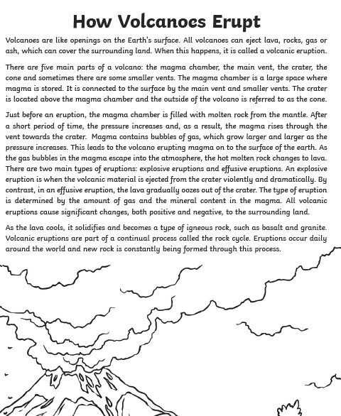
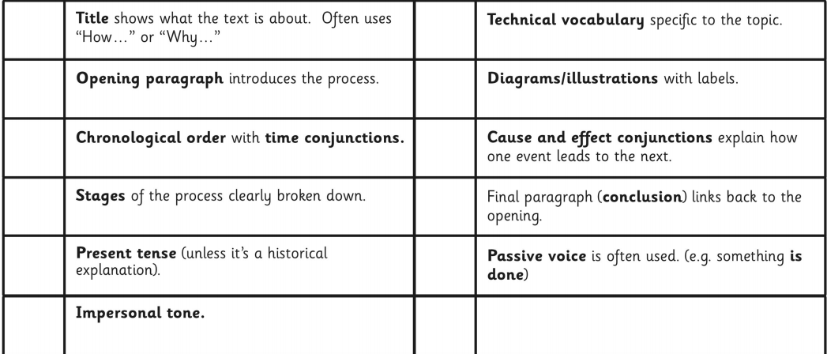
Can you identify the key features of this explanation text?

Slide 4
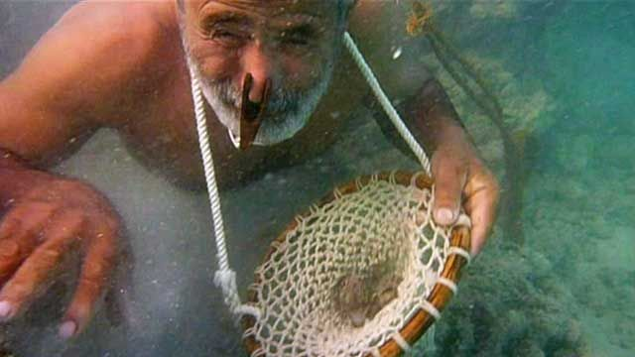
Can I write an explanation text?
Using all the information you have researched, your task is to write an explanation text about diving for pearls.

Slide 5


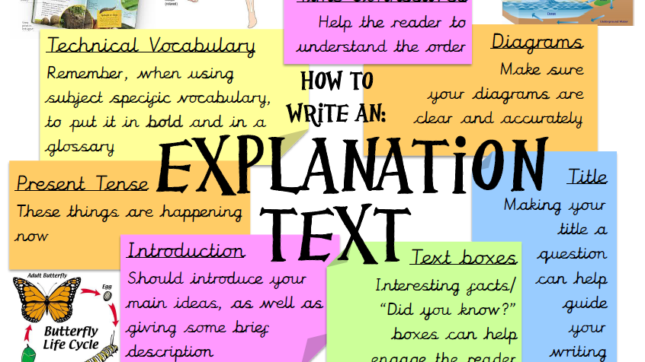
What are the features on an explanation text?
Use this sheet to help you!

