Slide 1
Tales from other countries
Can I research a topic and present my findings?

Slide 2
The Rat and the ship’s captain
Watch the following clip which tells the story of the rat and the ship’s captain
https://www.youtube.com/watch?v=qI3OPif4Enk

Slide 3


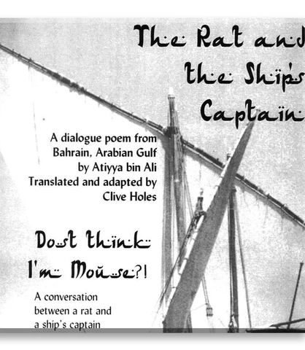
The rat and the ship’s captain
This poem was written in the 1930’s.
It tells the story of a real problem for a pearl boat captain….rats!
It is known as a debate poem and is a common form of poetry in the middle east.

Slide 4
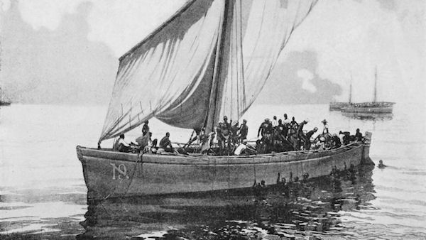
I wonder what other issues a pearl boat captain might have?
Can you research pearl boating and what it was like to work on a pearl boat.
You can present your findings however you wish.

Slide 5


What is the name of this boat?
What time did you start work?
Could you become rich?
Where do pearls come from?
https://www.youtube.com/watch?v=c1M68UofTAw
https://www.bbc.co.uk/news/blogs-magazine-monitor-30042226

