Slide 1
Tales from other countries
Can I identify features in a text?

Slide 2

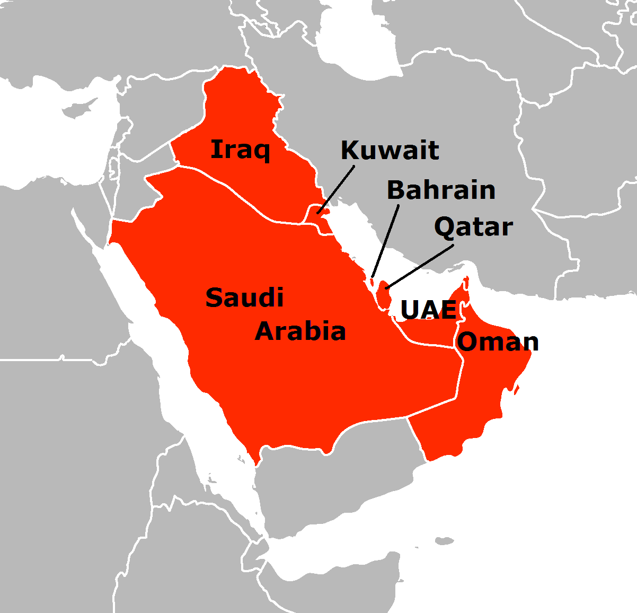
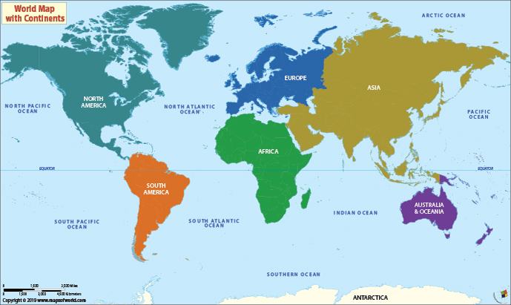
The stories we will be looking at originate mostly in the gulf states. Do you know where these are?
What do you know about this region?

Slide 3

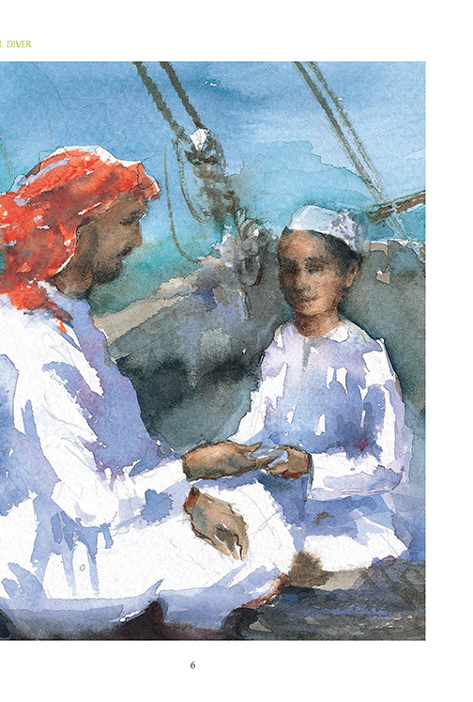
The pearl diver
Story by Julia Johnson
This story, carefully researched from oral and written sources - some dating from more than a hundred-and-fifty years ago - offers an insight into the way of life that sustained the Arabian Gulf right up until the discovery of oil.

Slide 4
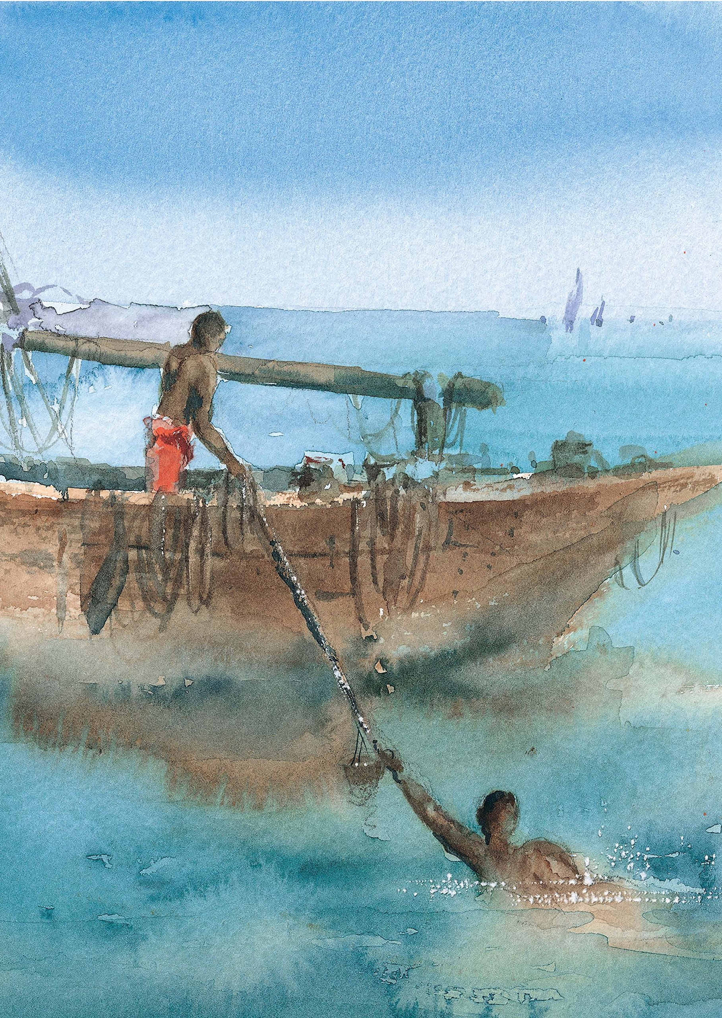
This is an extract from the pearl diver
Already he could swim like a fish, and he had been secretly practising holding his breath and slowly blowing out a stream of bubbles under the water. He wanted his father to be proud of him! It was said that Abdullah was one of the best divers. Saeed had heard the stories of how long his father could stay under the water, of how many oysters he could harvest, and of how deep he could dive.

Slide 5
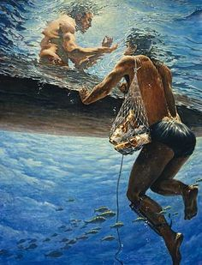
Only one man in twenty, it was said, could go deeper than sixteen fathoms. Saeed knew that the Nakhuda was happy to have his father on board because it increased his chances of finding a really special pearl. Those found in deeper water were supposed to have a finer lustre.
The crew, too, would rejoice in a valuable catch, for they would receive a share of the profits. “But aren’t you ever afraid, Father?” Saeed had asked. “You must learn the ways of the sea, my son, and know its secrets, “Abdullah had replied.
Saeed had wondered what he meant. “And I have Ahmed to look out for me,” he added, “he is a good hauler and I trust him as if he were my brother.”

Slide 6
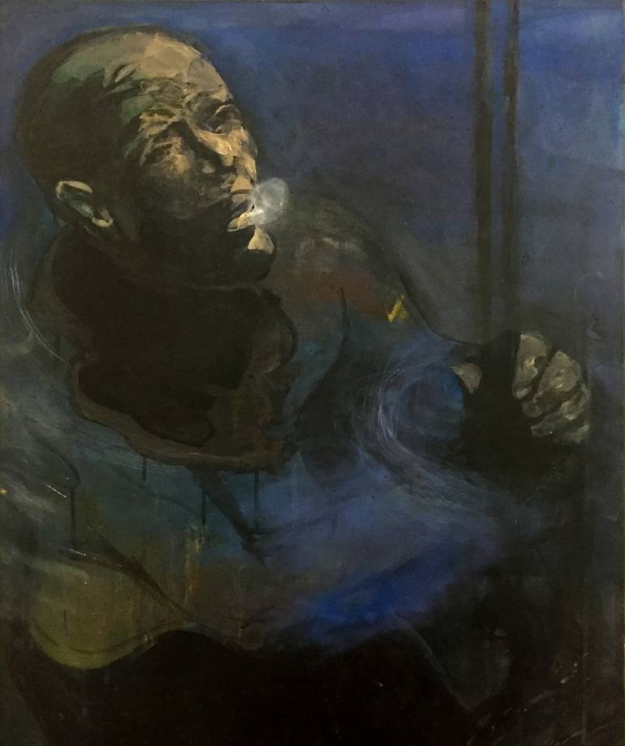
Every diver had a hauler, and Saeed knew that the relationship between them was a very close one. The diver depended on his hauler to pull him from the sea as fast as possible when he tugged on the rope to let him know that he was ready to surface.
Saeed turned now to see the men raising the huge white sails. The wind filled them, and the sambuk gathered speed. All around him other boats flew over the sea. Saeed thought they looked like a great flock of big white birds. And in their wake dolphins leapt and dived. This was a sign of good fortune. Saeed felt happy.

Slide 7
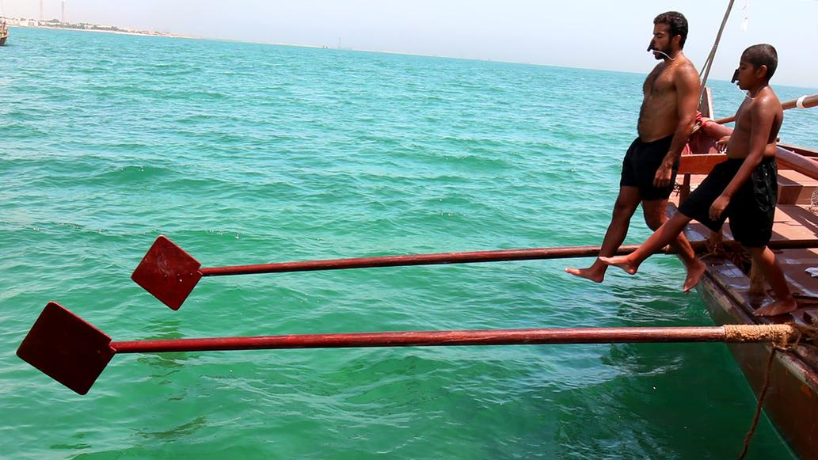
What is pearl diving?
Pearl diving was a way of life in this part of the world up until the 1950’s and the discovery of oil
Follow the link to find out more about it.
What is pearl diving?

Slide 8
Features of a text
What are the features you would expect to see in a story?
Click on the links to find out what they are!
Powerful verbs
Variety of sentence structures
adjectives
Similes
metaphors

Slide 9
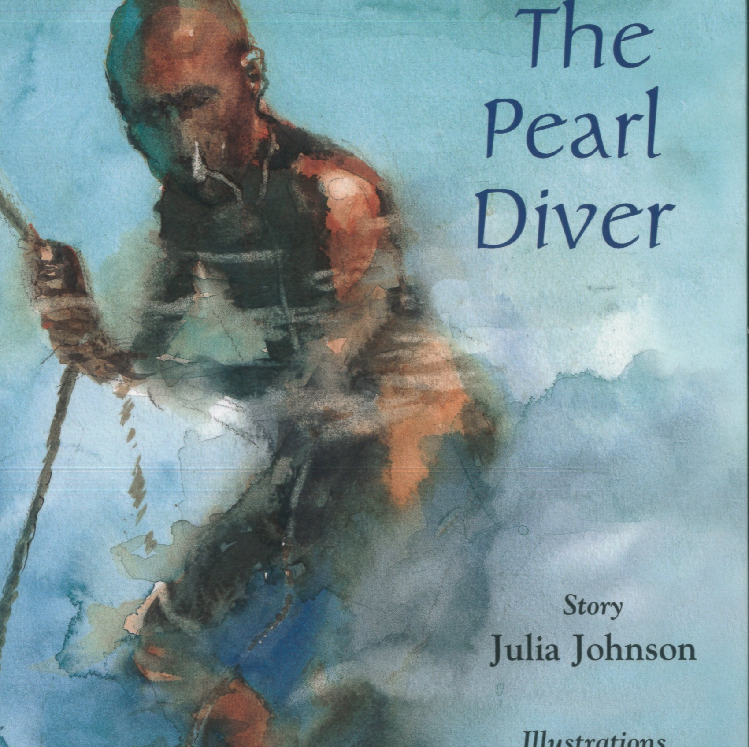
Your task
Can you look at the extract and identify all the features we have discussed.
Create a colour key, each colour representing a different feature.
You can use Microsoft word or paper, it’s completely up to you

Slide 10
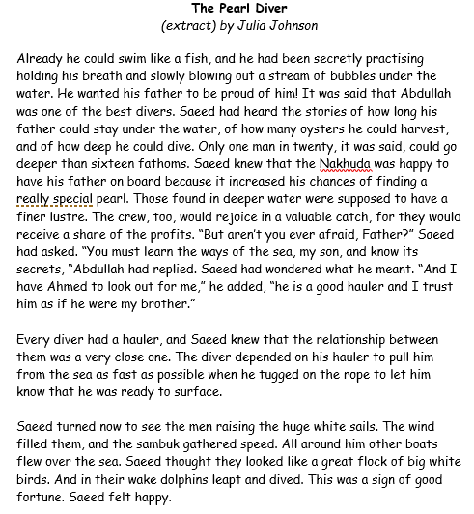
Pearl Diver

Slide 11
Powerful verbs
Powerful verbs are verbs that are descriptive and exciting. They can make a piece of writing much more fun to read. Verbs are words which describe an action or state of being, whilst powerful verbs are verbs that engage the reader.

Slide 12
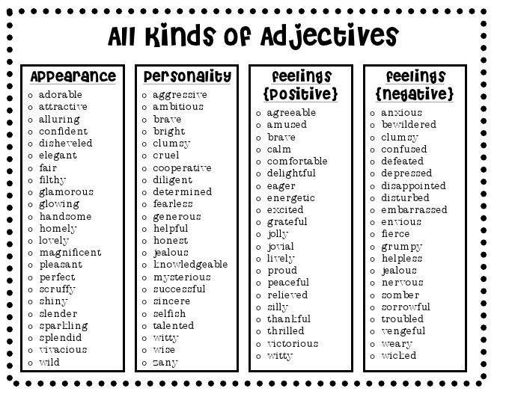
adjectives
Adjectives describe, identify or modify a noun or a pronoun!
Features of a text

Slide 13
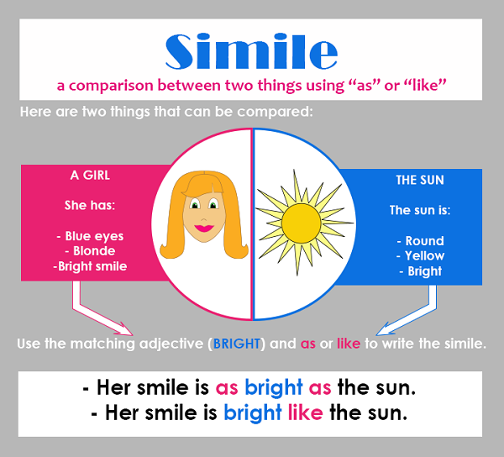
Similes
Features of a text

Slide 14
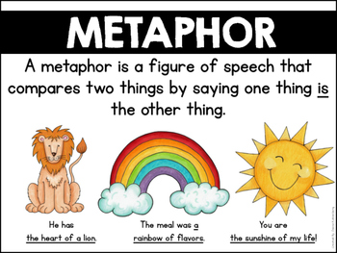
Metaphors
Similes and Metaphors bbc bitesize

Slide 15
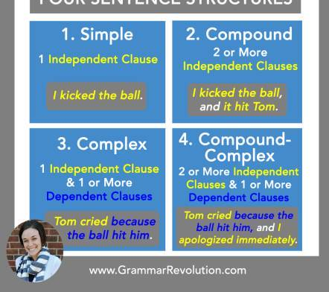
Sentence structure
Features of a text

