Slide 1
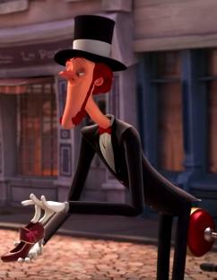
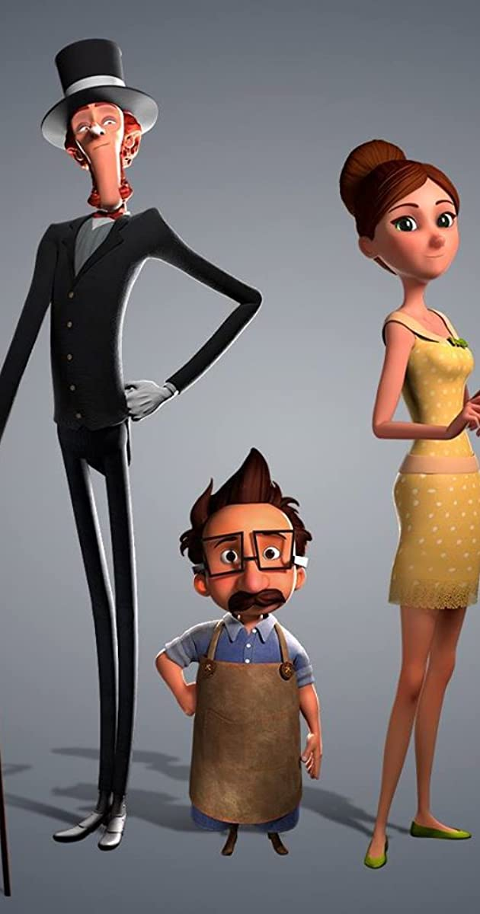
The Little Shoemaker
The Shoe Seller from St Etienne
Lesson 7

Slide 2
Can I re-write the story from a different perspective?
Can you use a dictionary (or google) to find the meaning?
Instead of writing about Mr Botte, we will be writing about the Shoe Seller from St Etienne.
You will change your story around and tell it from the perspective of the shoe seller.
What do we mean by a different perspective?

Slide 3
How can we write the story from another perspective?
The Little Shoemaker
The shoe seller from st Etienne
Once upon a time, down a beautiful Parisian street…..
Once upon a time, a travelling Shoe Seller reached a beautiful Parisian street…
Just before he could sell the luxurious shoe to the lady, a strange, tall man, with a cart made of wood stopped outside the shop….
The Shoe Seller could see a potential customer, a young lady would definitely want to buy his fabulous shoes….
It wouldn’t be long now. The Shoe Seller’s superior footwear and infinitely larger choices meant that he would no longer have any competition…..
Try as he might, and despite offering all sorts of wonderful discounts, Mr Botte could not make any money. The Shoe Seller had won…

Slide 4
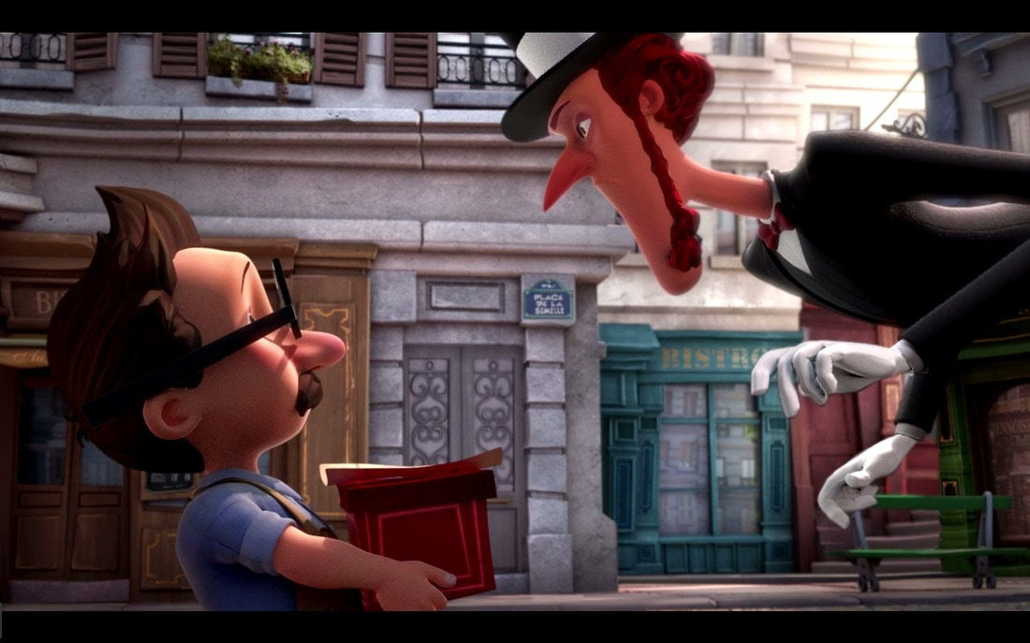
Character descriptions!
In lesson 1, you created some character descriptions. These would still be the same.

Slide 5
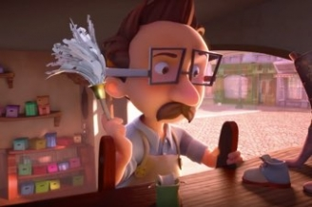
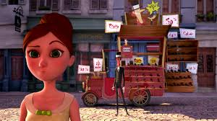
Dialogue (speech)
You created dialogue in lesson 2 which you could still use. Or you could create new dialogue.

Slide 6
Can I re-write a story from a different perspective?
Your task
Want to be challenged?
Can you re-write part of your story from the perspective of the Shoe Seller?
Can you give the Shoe Seller a name?
Can you write the whole story from a different perspective?
Can you give the Shoe Seller a name?
Maybe it’s the magical Mr Botte who is the bad guy?

Slide 7
Can I re-write my story from a different perspective?
Once again, you can use paper or the computer, it is completely up to you!
Good Luck!

