Slide 1
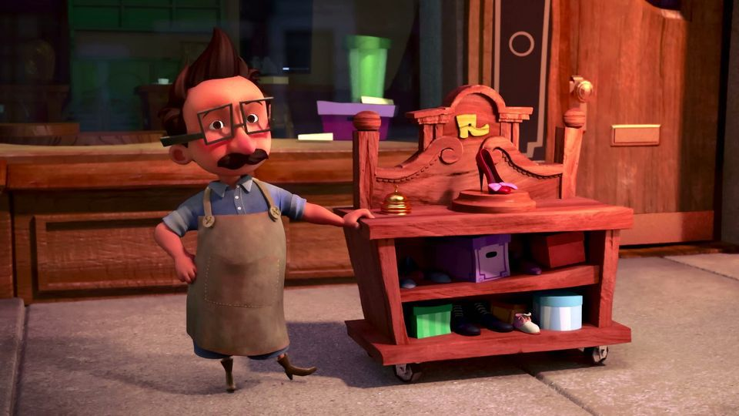
The Little Shoemaker
Lesson 5

Slide 2
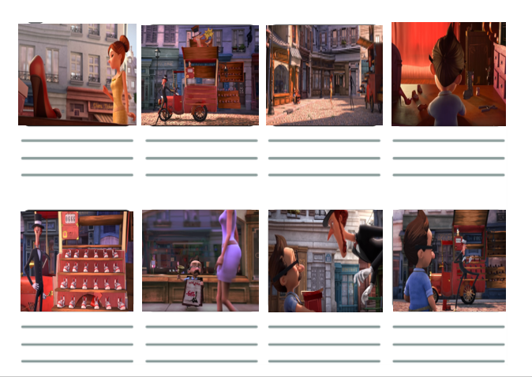
Your Storyboard
Your story board should tell the story of the Little Shoe Maker.

Slide 3
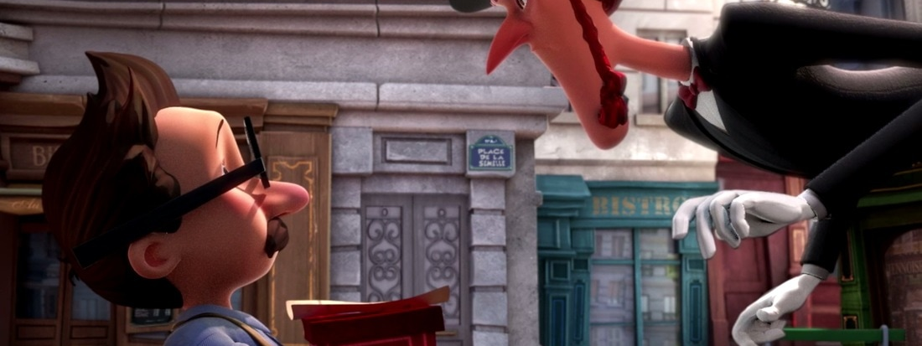
What are the features of a good fairy tale?
“I have a gift for you,” said Mr Botte.
“A gift?” Replied the Shoe Seller, “what could I possibly want from you!?”
“It’s my finest design,” The Shoe Maker exclaimed, “the most luxurious, the most beautiful pair of shoes the world has ever seen!”
“Really?” The Shoe Seller’s voice was full of intrigue. “Well, I shouldn’t be rude!”. With that, the Shoe Seller took the parcel.

Slide 4
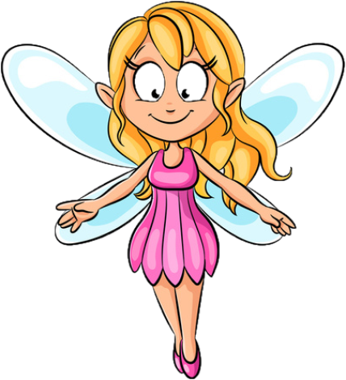
Fairy Tale Features
It DOES NOT need to include a fairy!
Use some form or variation of "Once upon a time"
Fantasy or make-believe elements
Enchanted setting - can include forests, castles, water or kingdoms
Clearly defined good and evil characters
Magical elements
Characters take on unusual forms (giants, witches, dwarfs, talking animals)
Groups of 3 (objects, people or events)
Clearly defined problem, climax and resolution
Most often they have a happy ending

Slide 5
What can help me create my writing?
Alan Peat sentences - The more the Shoe Maker tried, the more difficult it became to sell his shoes.
Year 5/6 word list

Slide 6
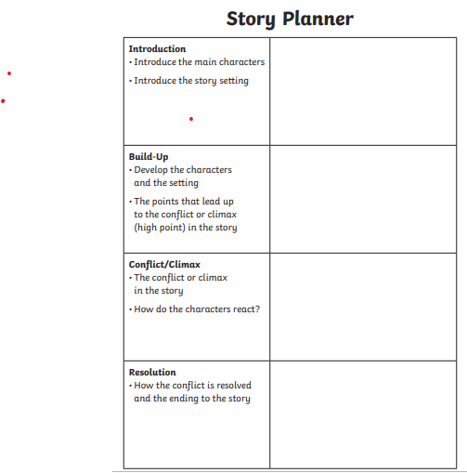

Can I plan The story of the Little Shoemaker?
You will be planning the story of the Little Shoemaker.
You can use the template provided..
Or you can plan it however you wish using Microsoft word, Microsoft publisher or making notes on paper..

Slide 7
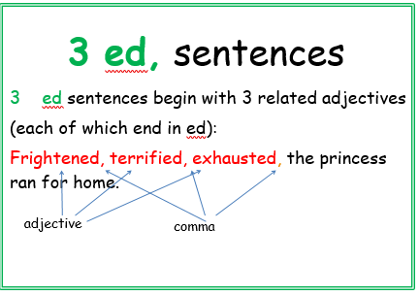
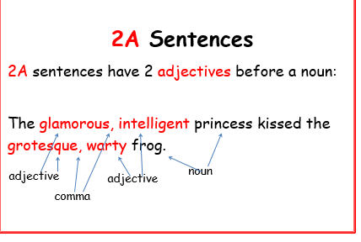
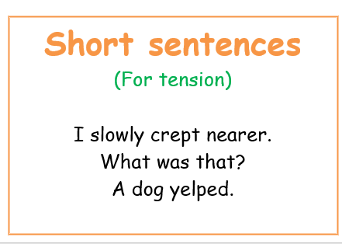
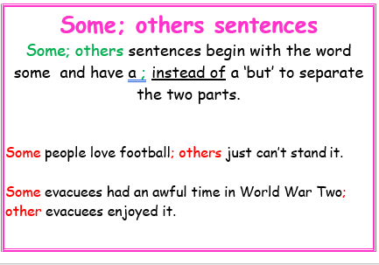

Slide 8


