Slide 1
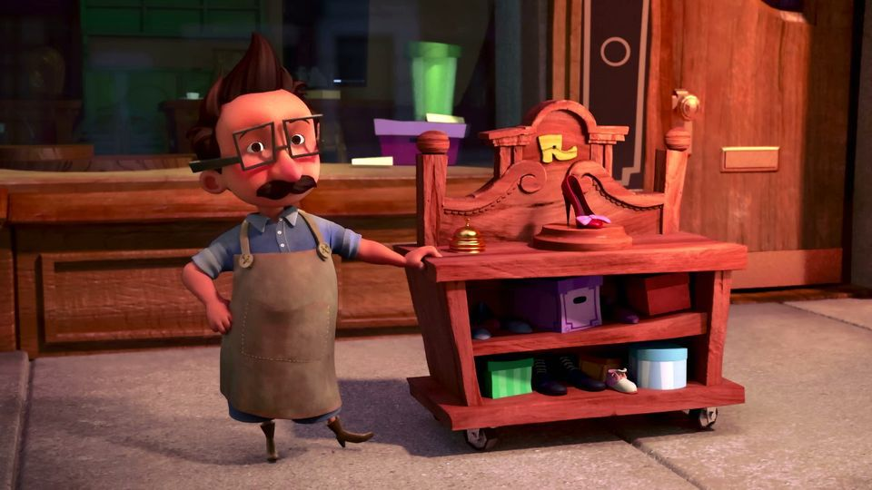
The Little Shoemaker
Lesson 3

Slide 2
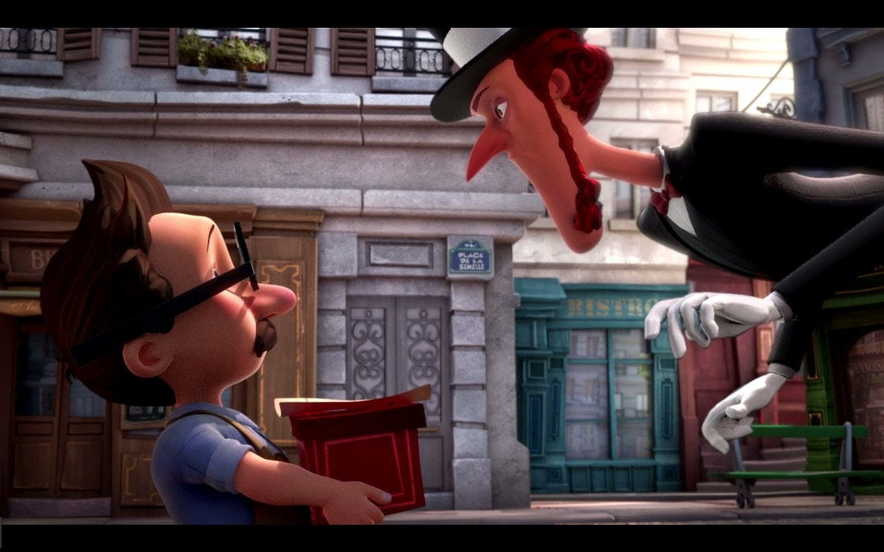
Can you punctuate the text to show what is being said?
I have a gift for you said Mr Botte. A gift replied the Shoe Seller, What could I possibly want from you! It’s my finest design, the most luxurious, the most beautiful pair of shoes the world has ever seen!
Really? The Shoe Seller’s voice was full of intrigue. Well, I shouldn’t be rude. With that, the Shoe Seller took the parcel.

Slide 3
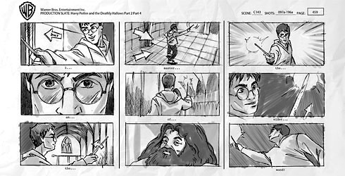
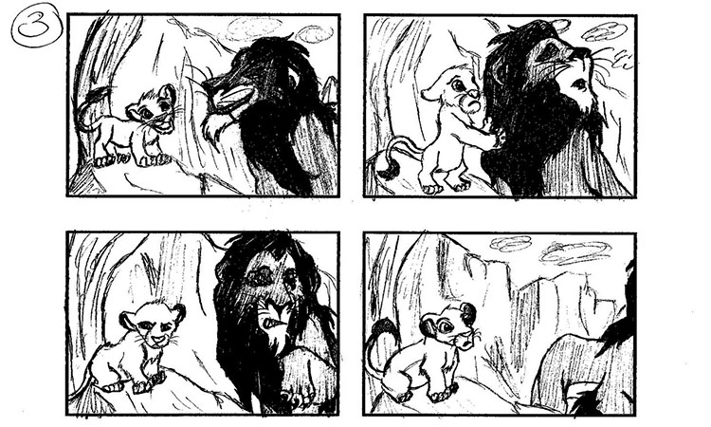
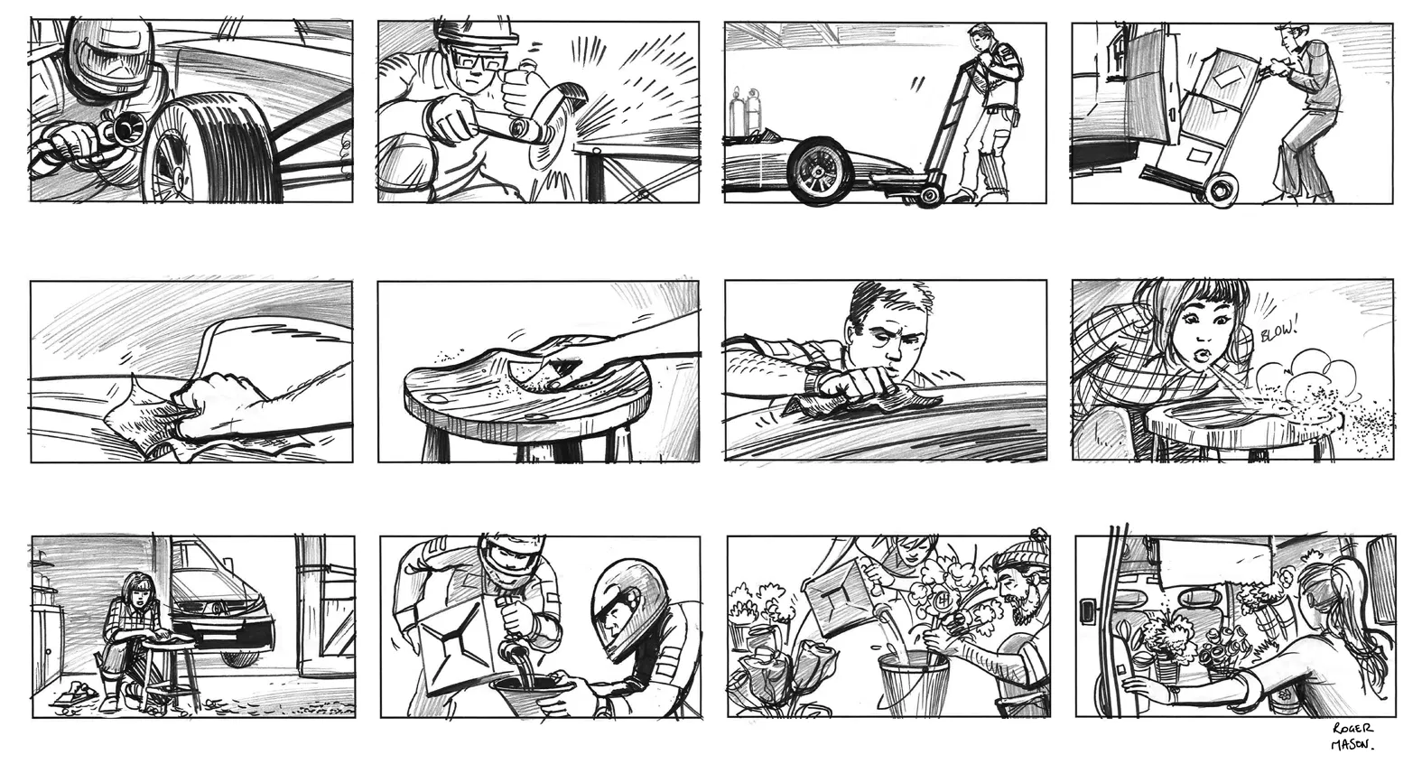
Creating a storyboard
A storyboard is a good way to show our understanding of a story.
The Lion King!!!!!!!!
Which film is this from?
Storyboards are used by film makers before they make their films!
Harry Potter

Slide 4
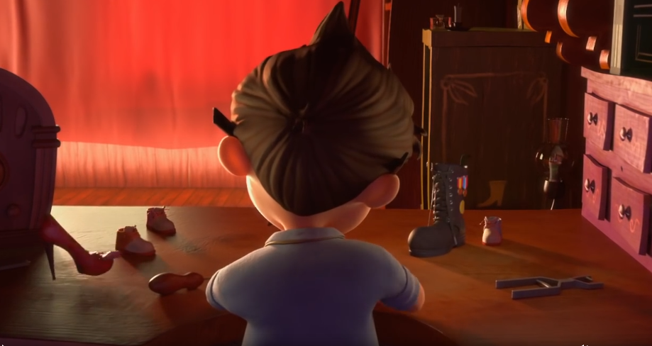
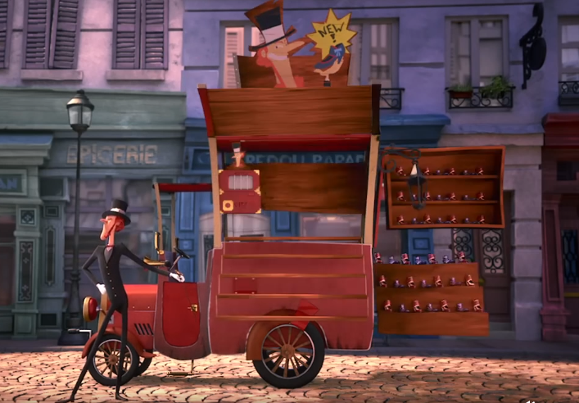
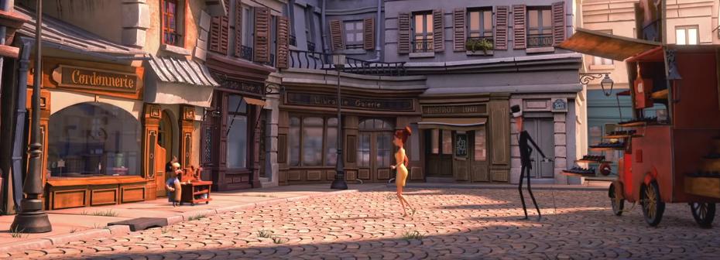
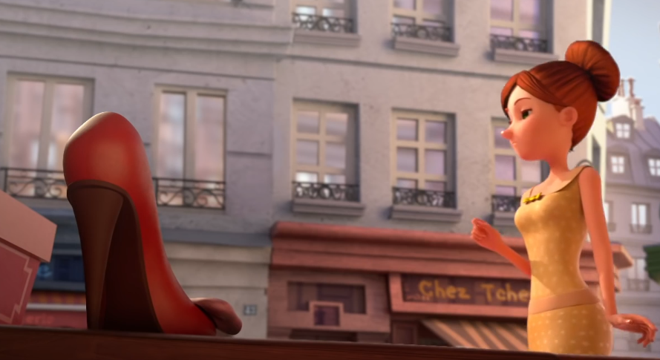
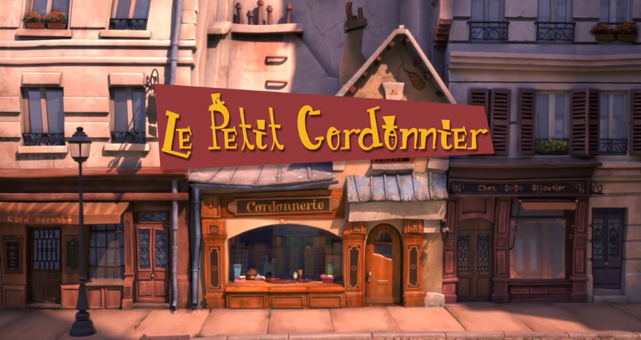
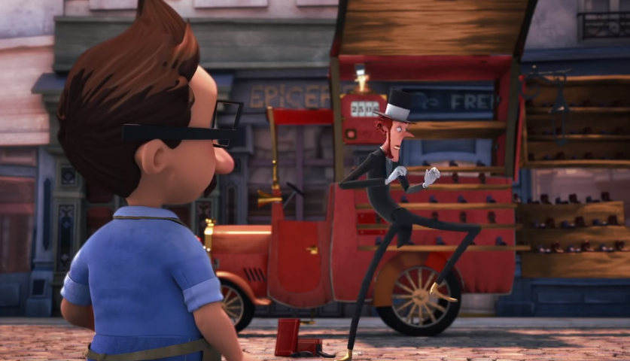
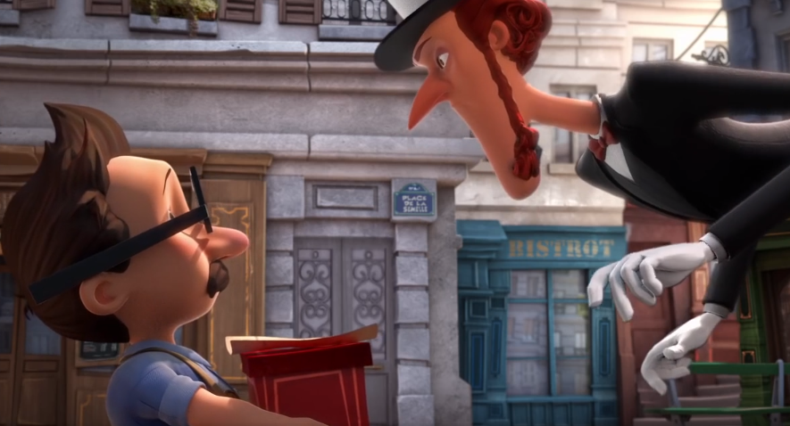
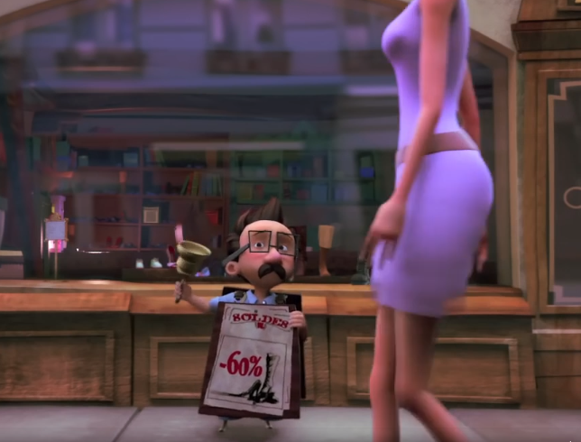
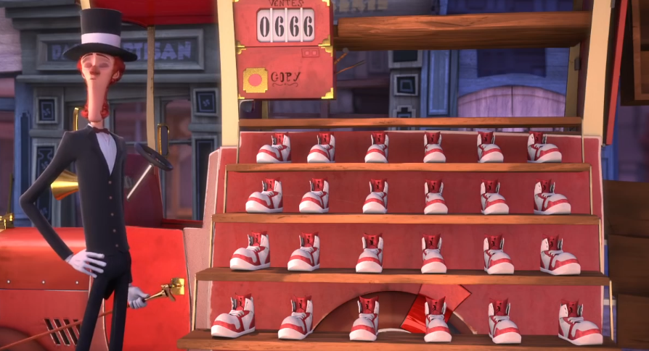
Can you put these pictures in order from the story?

Slide 5

Can you tell the story using the pictures and a story board?

Slide 6
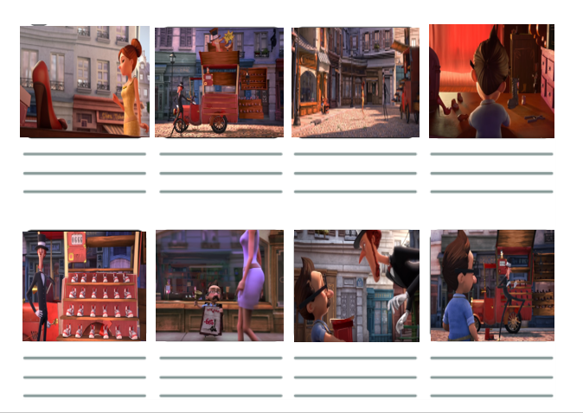
Complete the storyboard template.
You can use the template provided to draw your own pictures or you can use the one provided.
You could also create your own storyboard using Microsoft publisher or even using power point, it’s completely up to you!

Slide 7
Did you get it right?

