Slide 1
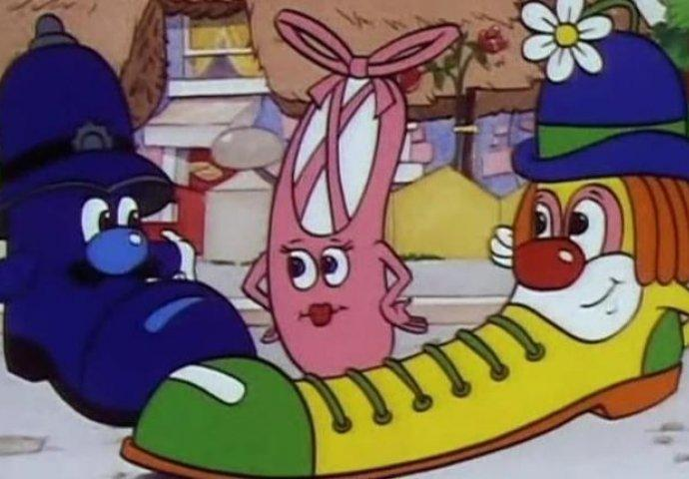
The Little Shoemaker
Lesson 2

Slide 2
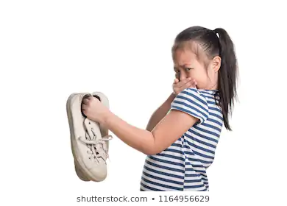
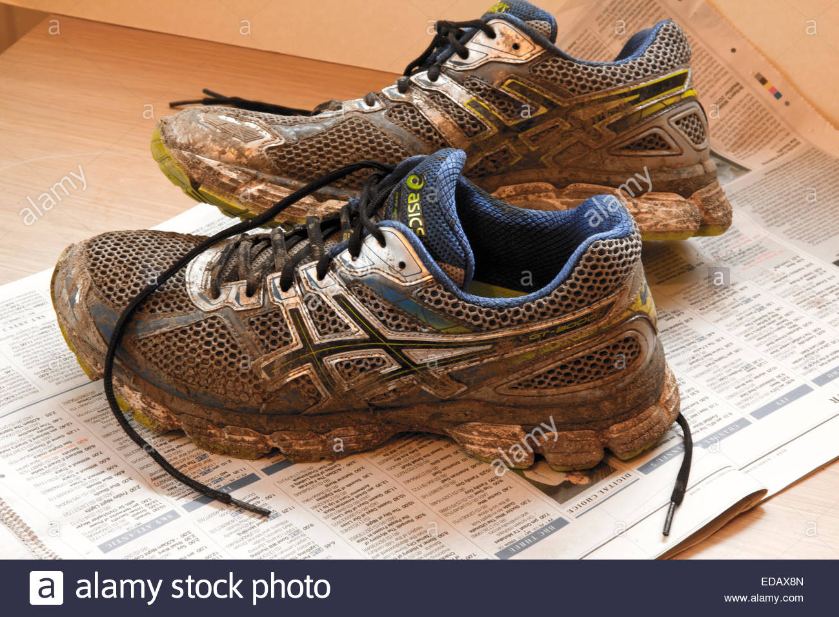
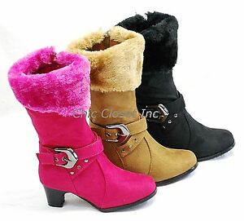
What if your shoes could talk?
What would your shoes say to you if they could talk?
Draw or take a picture of your shoes and write down all the things they would say to you!

Slide 3
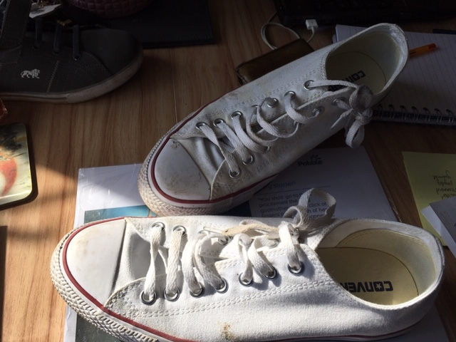
Mr Alsop’s Favourite trainers!
Why are we on the table?
Isn’t it about time you put us on?
I want to be in the sun!
I’m not as white as I used to be….being clean is just a memory!
Untie my laces please!

Slide 4
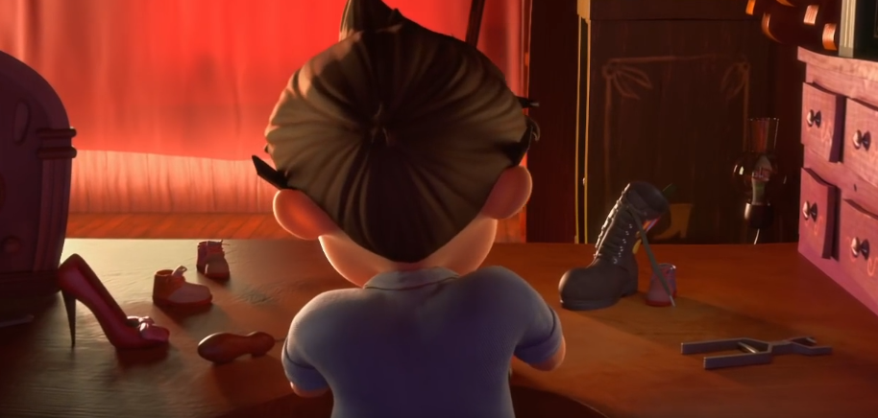
What are the shoes saying to the Little Shoe Maker
In this scene, Mr Botte is creating a brand new shoe, his best ever to show the Shoe Seller who is the best.
What do you think his shoes are saying to him right now?
What might he say to them?

Slide 5
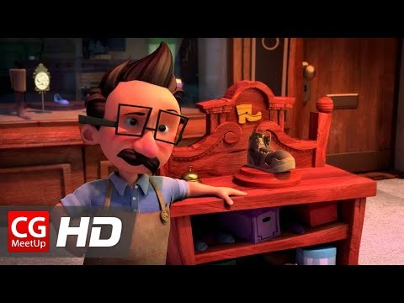
When you watch the film can you think about what the characters maybe saying to each other.

Slide 6

Can you create some dialogue between the shoes and Mr Botte?
Don’t forget how to use speech marks for direct speech!
Click on the picture for the link!

Slide 7


