Slide 1
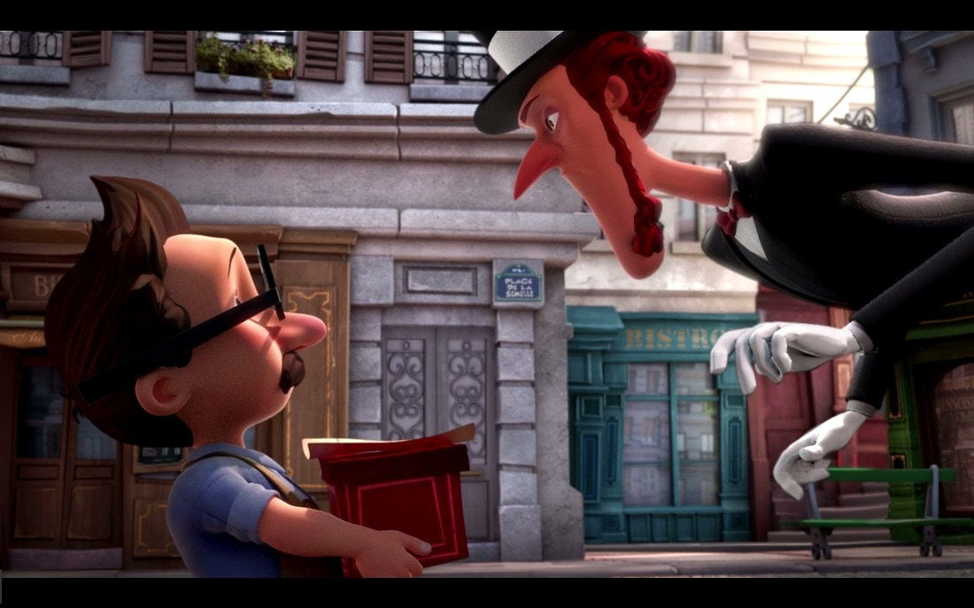
The Little Shoemaker
Lesson 1

Slide 2
In a timeless Parisien street there is a little shoemaker called Mr Botte. He makes and sells a special kind of shoes and business is good. However, the little shoemaker's life is about to change... a new shoe seller is in town and he will do anything to gain business. Mr Botte's business starts to fail. How will he cope? Maybe he will get some help from unexpected quarters.
- The little shoemaker

Slide 3
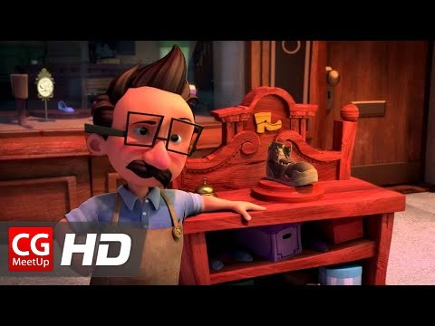
Le Petite Cordonnier
This is French for The Little Shoemaker!
Please watch the video!

Slide 4
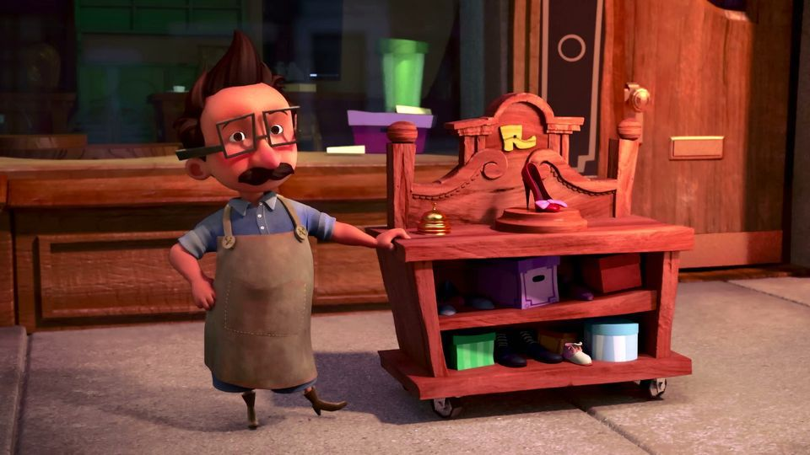
The Little Shoemaker
Can you create a character description of the Little Shoemaker?
What’s he like? Is he kind? Happy? What ideas do you get from the film?

Slide 5
Mr Botte is a quiet and content man who enjoys his own company…..

Slide 6
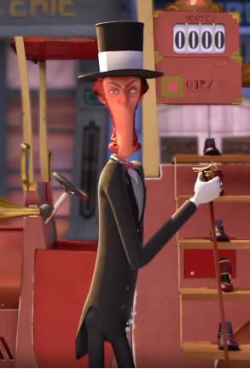
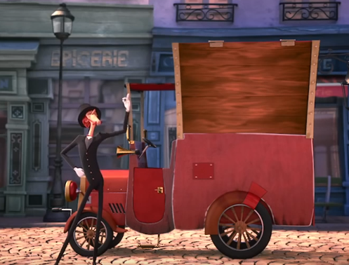
The Shoe Seller
Can you create a character description of the Shoe Seller
What’s he like? Is he mean? Happy? What ideas do you get from the film?

Slide 7

The Shoe Seller is not a very nice man. He is selfish because…..

