Slide 1
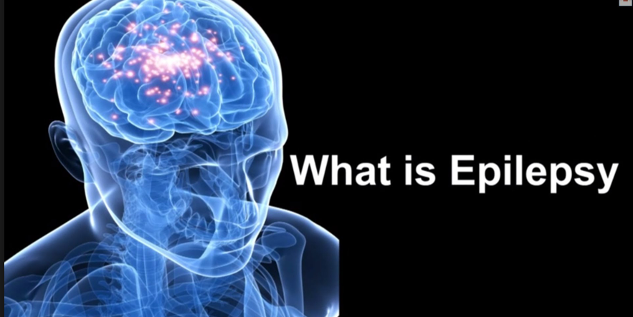
Epilepsy at Moorlands: What should you do?
By Jamal And Bethan

Slide 2
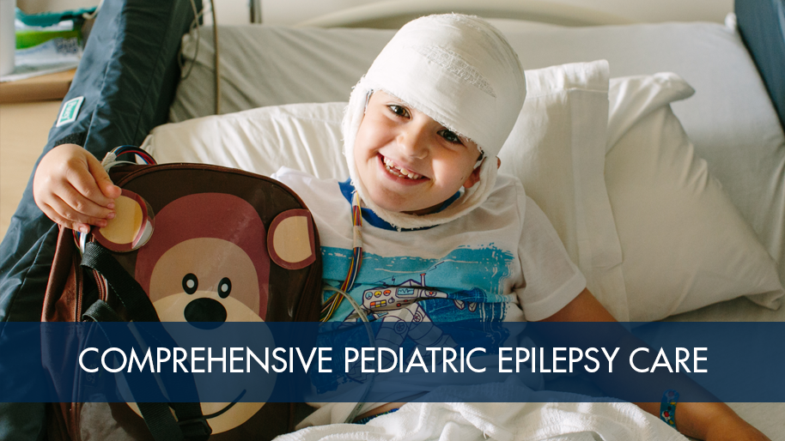
This is what epilepsy can lead to:
Epilepsy facts. Epilepsy is a neurological condition that can affect anyone, at any age and from any walk of life. Epilepsy affects around one in every 100 people in the UK. Every day, 87 people are diagnosed.

Slide 3

What to do if you get scared:
We know it may seem scary but you need to remain calm.
Teachers have special training in First Aid to deal with these episodes.
If the child is about to bang their head when they fall try to prevent it.
If you can’t prevent it and the child is on the floor put something soft (your coat etc.) underneath their head.
If they start shaking get immediate help from an adult: the adults may be used to it.
The child is used to these episodes so don’t worry; they will be just fine.

Slide 4


This is an animated video (age appropriate)
Ben and Sunita are having a picnic. The Ben has a seizure. This is what you can do.

Slide 5
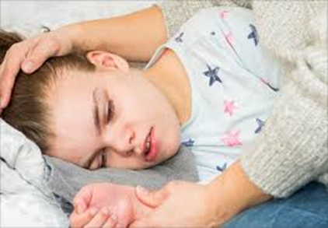
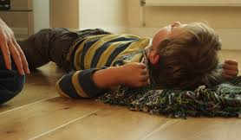
This is a common medical condition.
This is what an episode of epilepsy will look like.
Place something soft (cushion/coat) under the head of the patient.

Slide 6
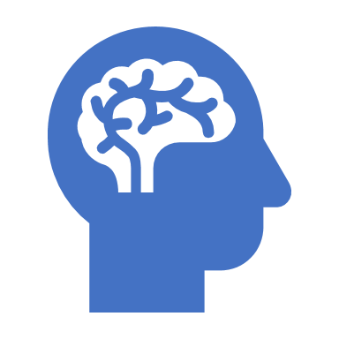
After The Seizure
After the seizure the patient may feel drowsy/weak/ Do not worry: they are used to this since some people have a seizure 3-4 times a day. This completely normal for the patient.

Slide 7
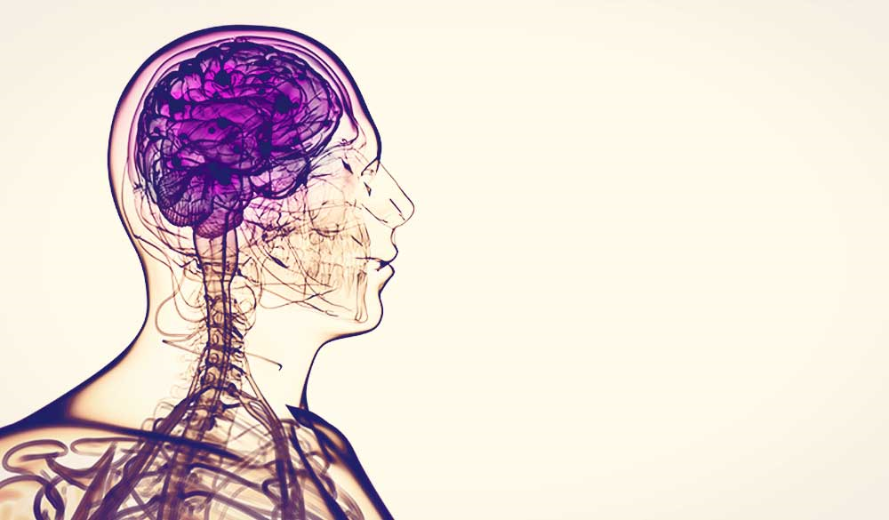
Awareness
Thank you for watching our Epilepsy awareness powerpoint. All of these steps are crucial if you see someone having an epileptic fit.

